Slide 1
The global economy: From gloom to boom?
Josh Felman
JH Consulting
EMC
December 15, 2023

Slide 2
What a difference…
A year ago, the global economy seemed gloomy
Yet the past year turned out to be boomy
How did this happen?
What about 2024?

Slide 3
Forecasts vs frameworks
To answer these questions, we need a framework
Since this is an academic conference, we need an academic framework
But since this is the closing speech, the framework needs to be simple!

Slide 4
Price
AS
A
AD
Output

Slide 5
AS’
Price
AS
B
A
AD’
AD
Output
Pandemic

Slide 6
The great policy debate
Inflation prompted a huge policy debate
One side, led by Larry Summers, sounded the alarm
The other side, led by Paul Krugman, said this was…alarmist!

Slide 7
Price
AS
A
AD
Output
Krugman’s Forecast

Slide 8
Price
AS
A
C
AD
AD’’
Output
Recession
Krugman’s Warning

Slide 9
Price
AS’
B
AD’
Output
Summer’s Forecast

Slide 10
AS’
Price
AS
B
A
D
AD’
AD
AD’’
Output
Recession
Summer’s Warning

Slide 11
The Fed’s dilemma
Krugman: don’t tighten!
Summers: must tighten, sharply!

Slide 12
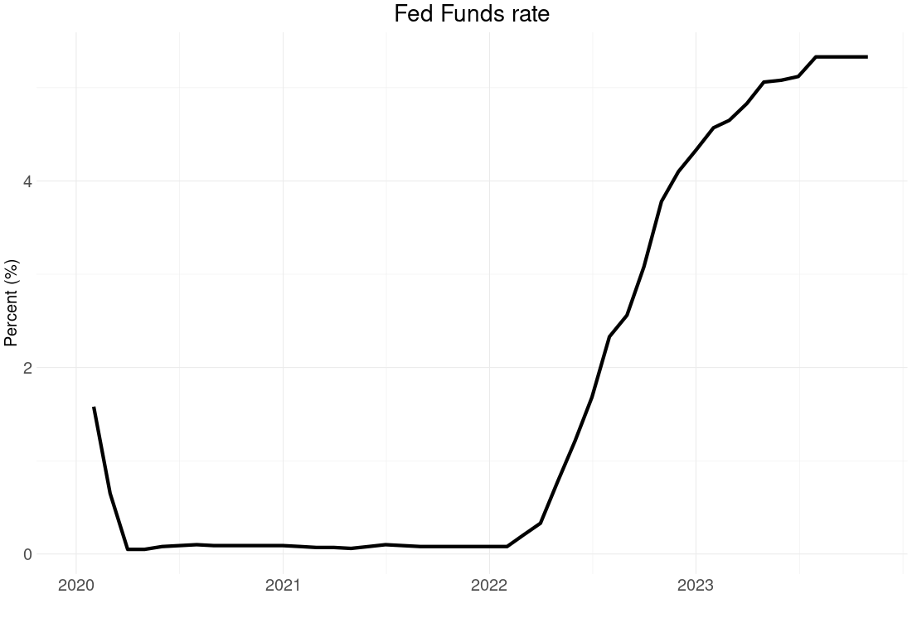
And the Fed decided to…

Slide 13
Finally…agreement!
Recession is coming!

Slide 14
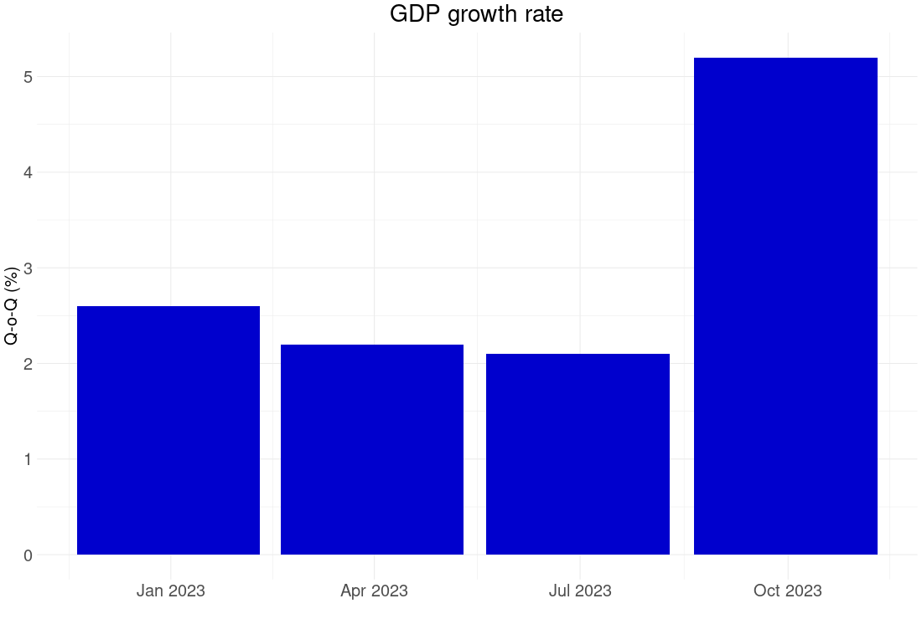
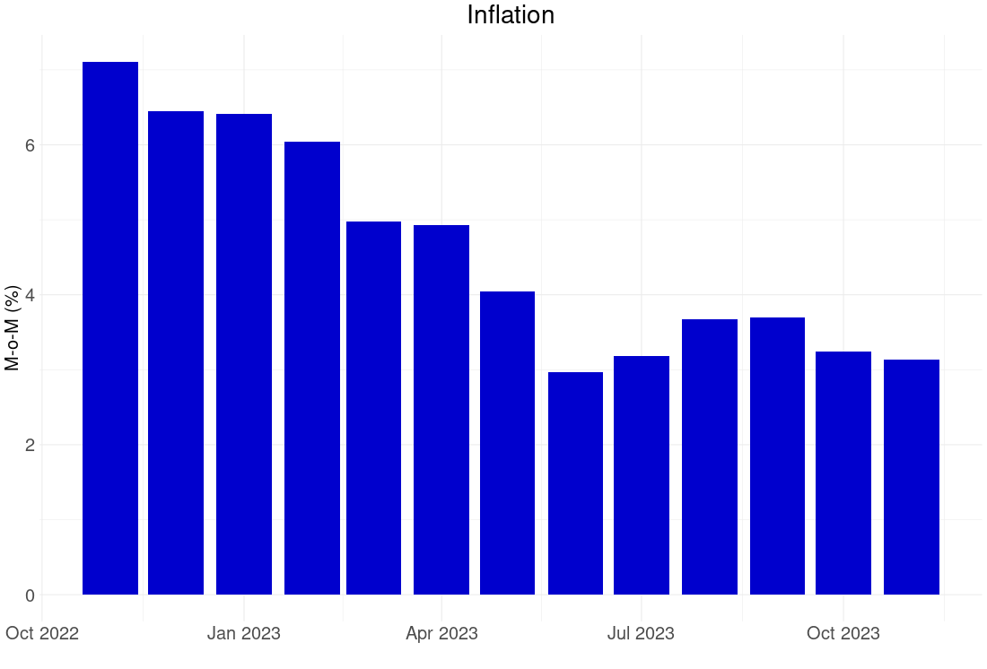
The miracle of 2023
USA

Slide 15
How did this happen?

Slide 16
The “soft landing”
Fed calibrated correctly
Workers came back

Slide 17
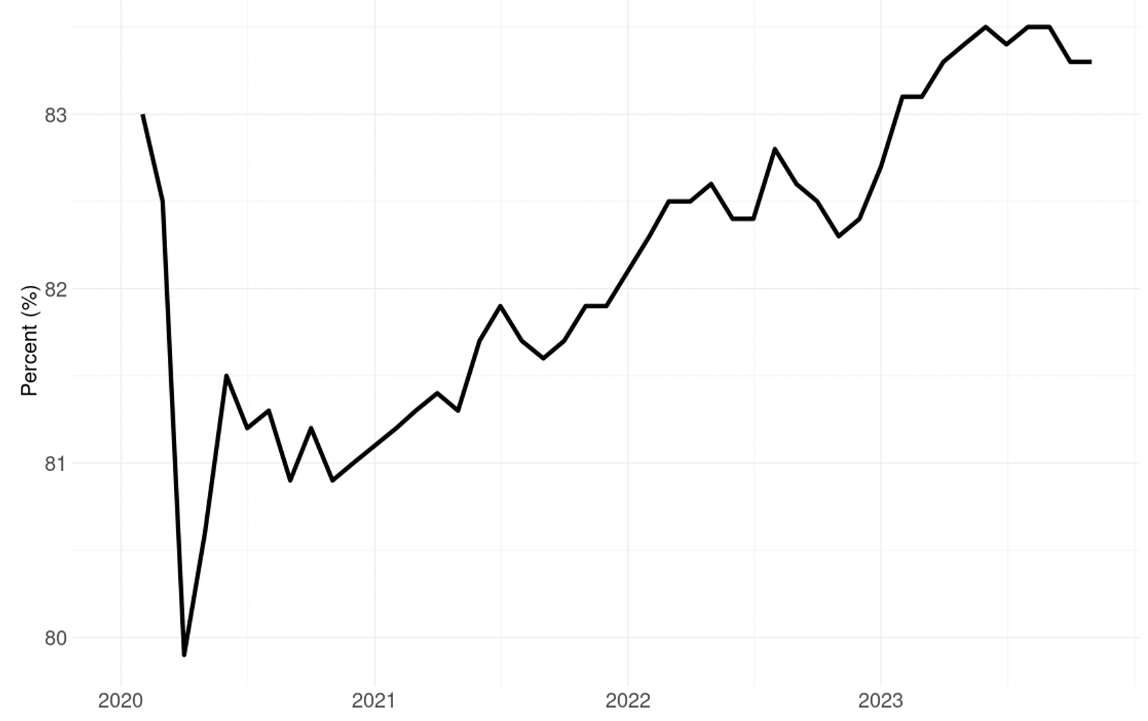
Labor Force Participation Rate : 25-54 years

Slide 18
AS’
Price
AS
A
AD’
AD
Output
Actual

Slide 19
Outlook for 2024

Slide 20
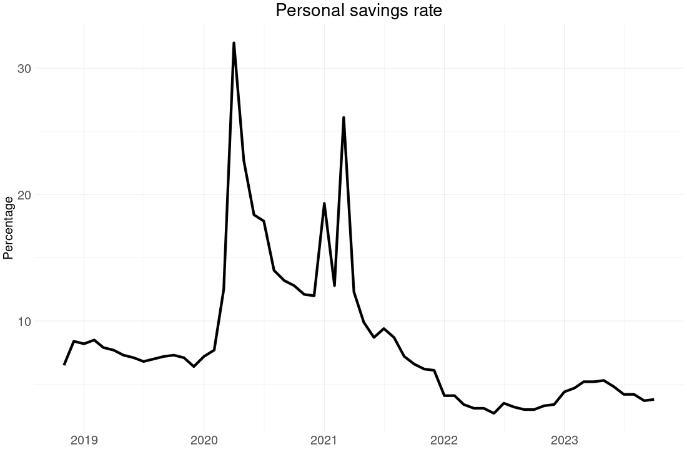
Consumers are out of ammunition

Slide 21
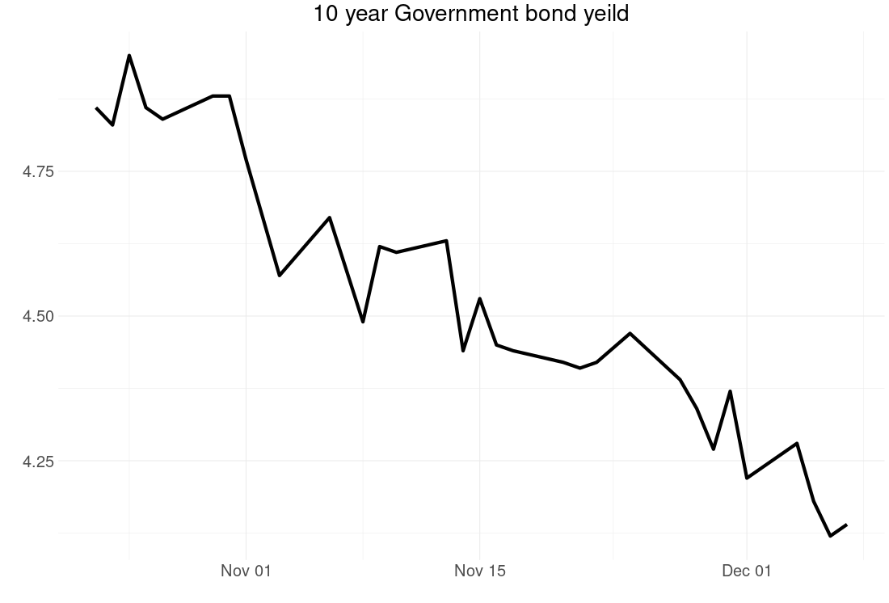
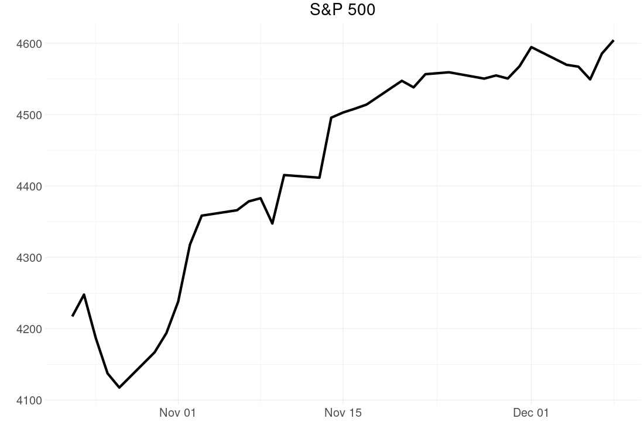
Fed has signalled it might cut rates

Slide 22
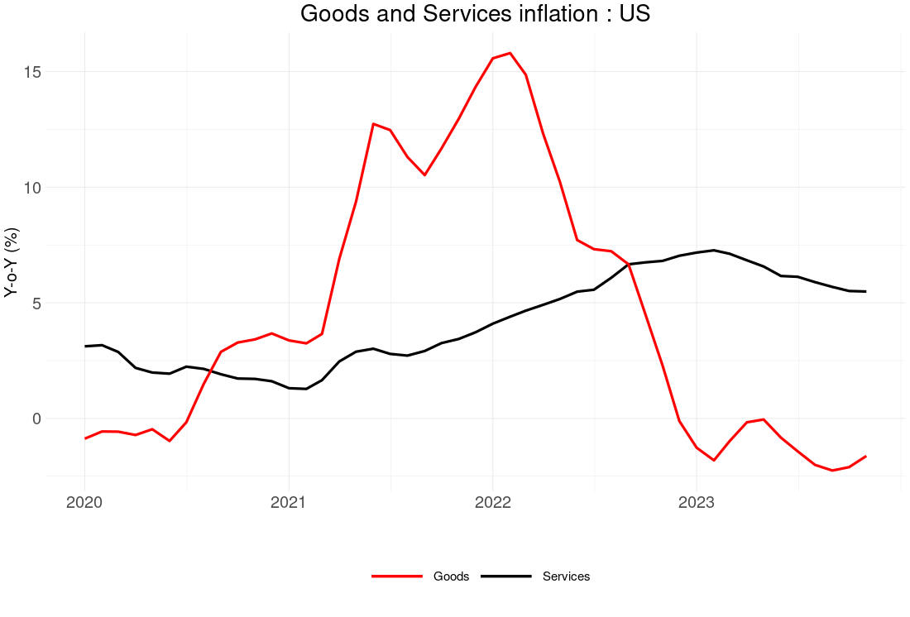
But inflation is still above 2 percent target

Slide 23
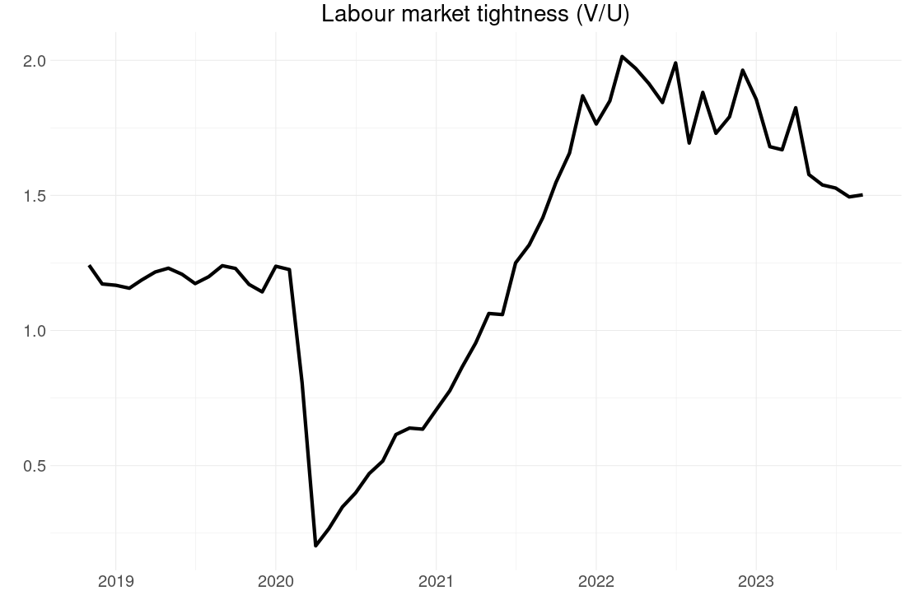
Watch the labour market!

Slide 24
Wage
L^{S}
A
L^{D}
Employment
Labour Market

Slide 25
Wage
L^{S}
B
A
L^{D}
Employment
Labour Market
Inflation

Slide 26
Wage
L^{S}
L^{S’}
B
A
C
L^{D}
Employment
Labour Market
Growth

Slide 27
Wage
L^{S}
B
A
D
L^{D}
L^{D’}
Employment
Labour Market
Recession

Slide 28
And now for something different…

Slide 29
The India puzzle
Strong overall growth…
But profound weaknesses
How can we understand this?

Slide 30
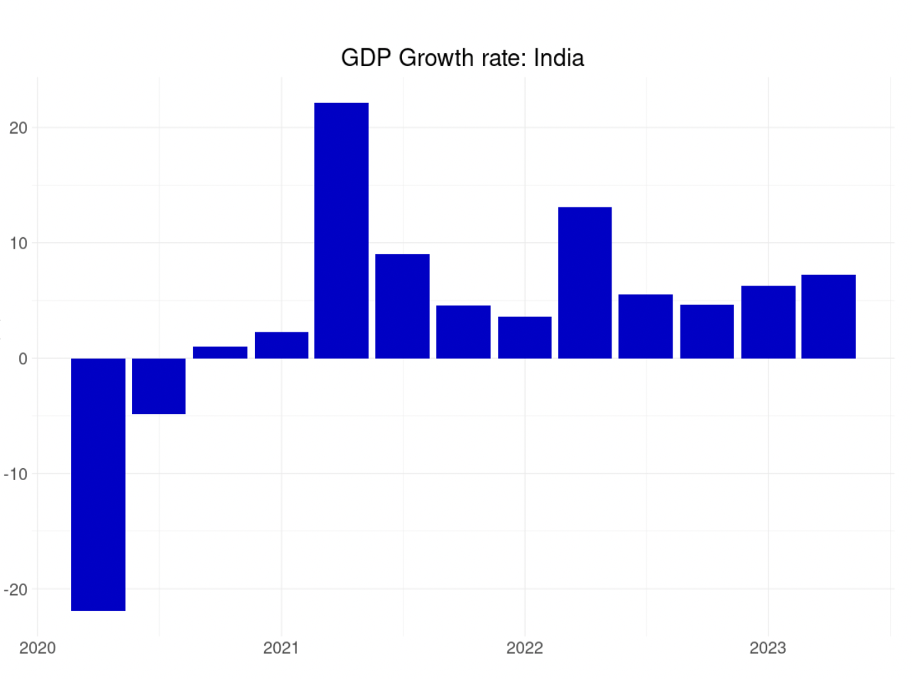
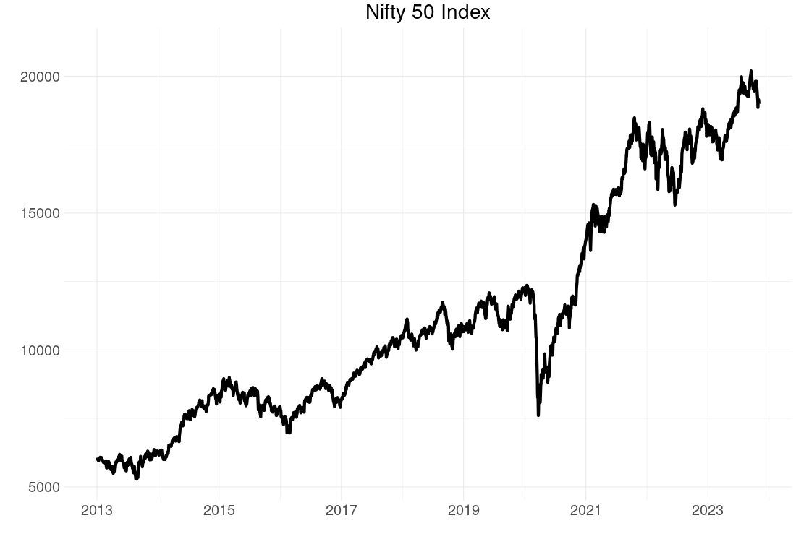
Roaring back from pandemic

Slide 31
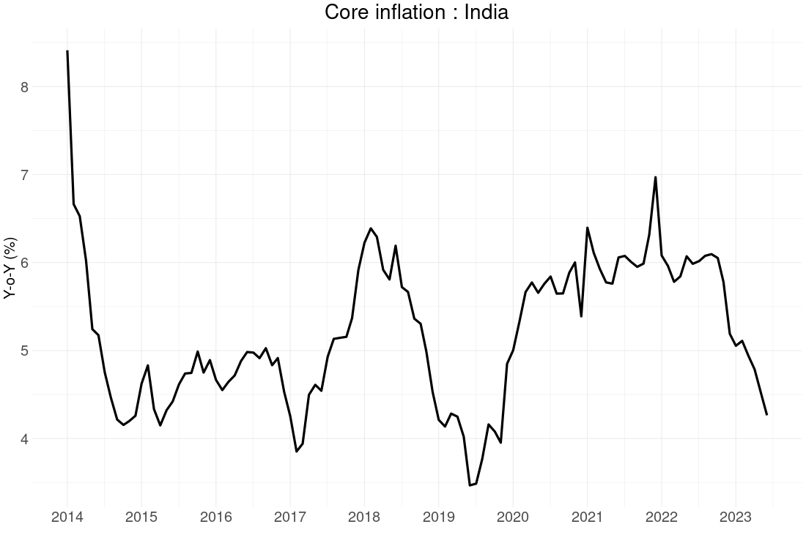
But core inflation falling

Slide 32
Even with accommodative monetary policy

Slide 33
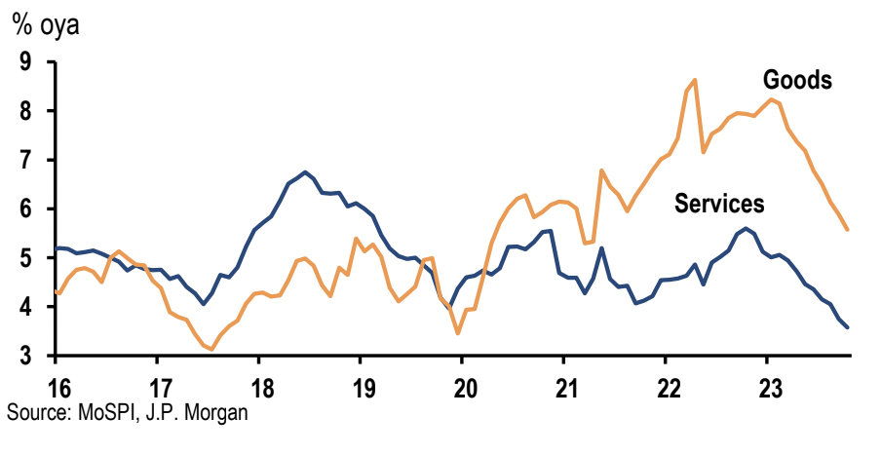
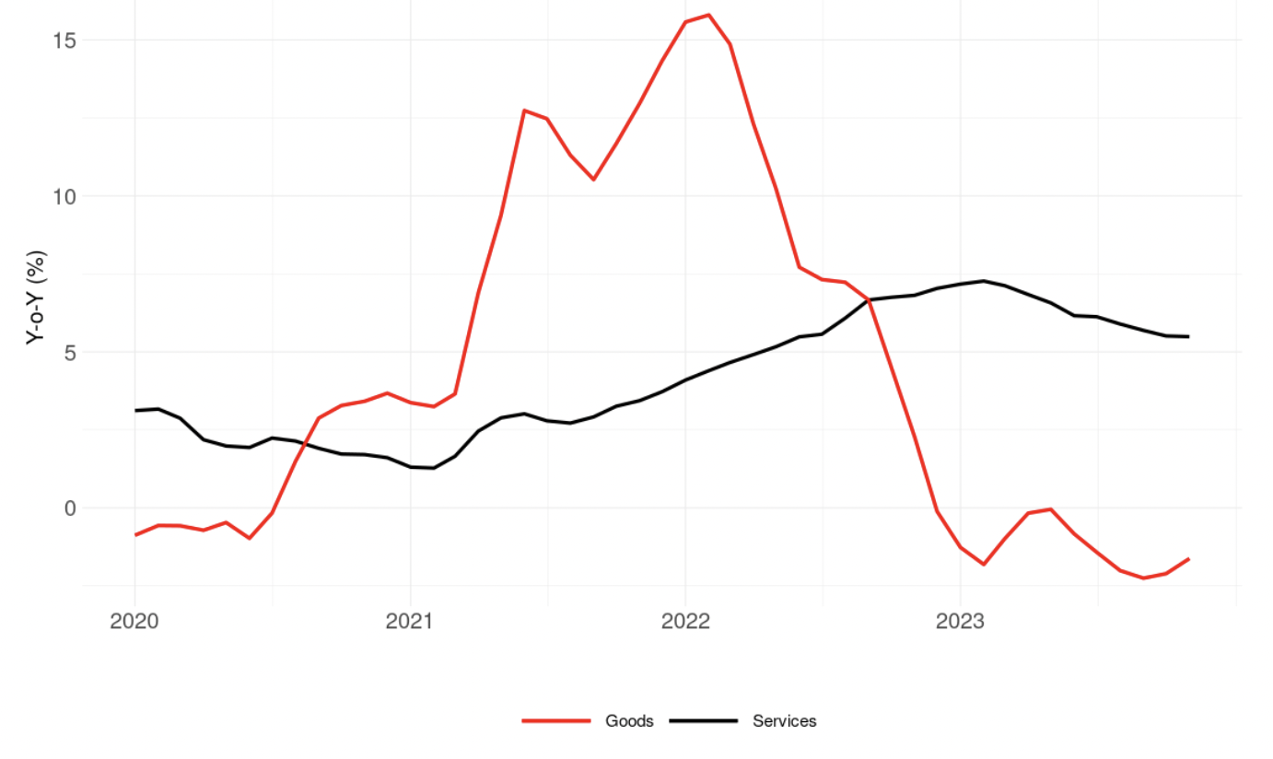
Unlike US, service inflation falling

Slide 34
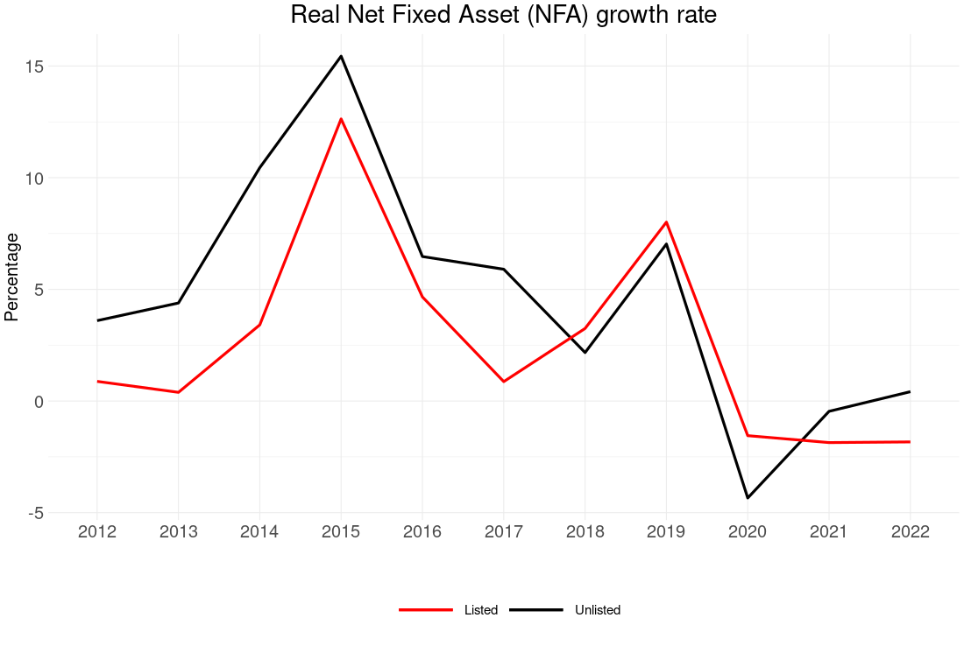
Investment weak

Slide 35
Two possible explanations
Growth overstated
Unusual pattern of growth

Slide 36
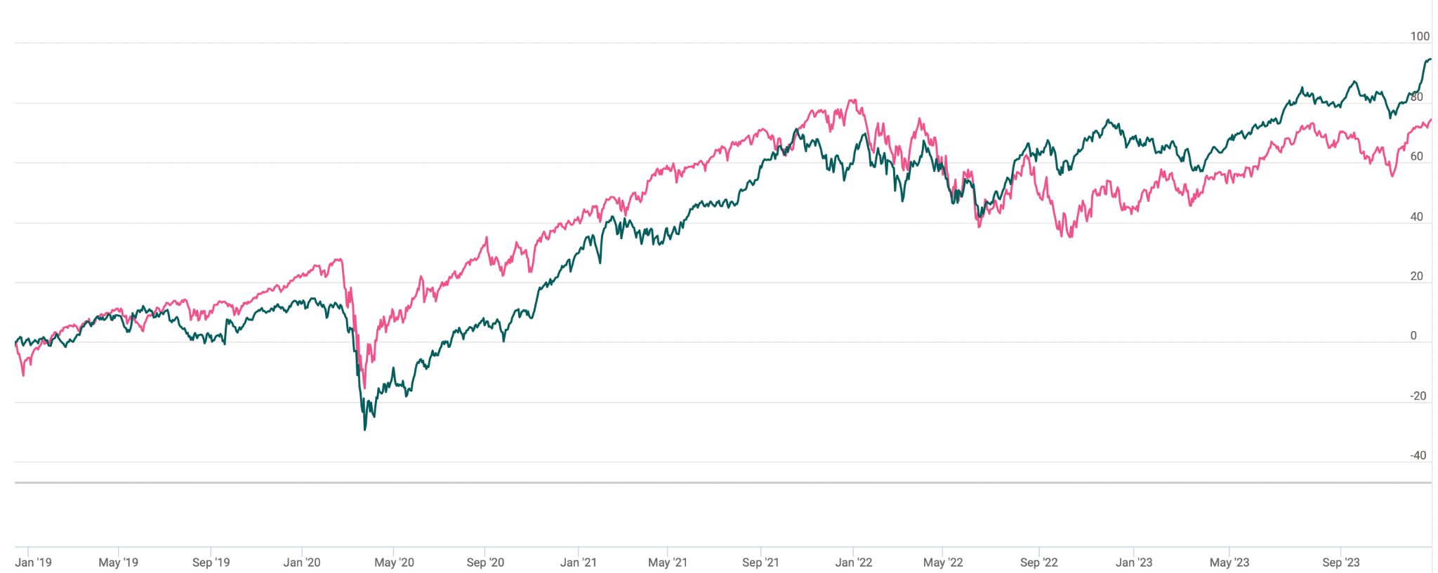
Integrated India

Slide 37
The three waves
2021
2022
2023

Slide 38
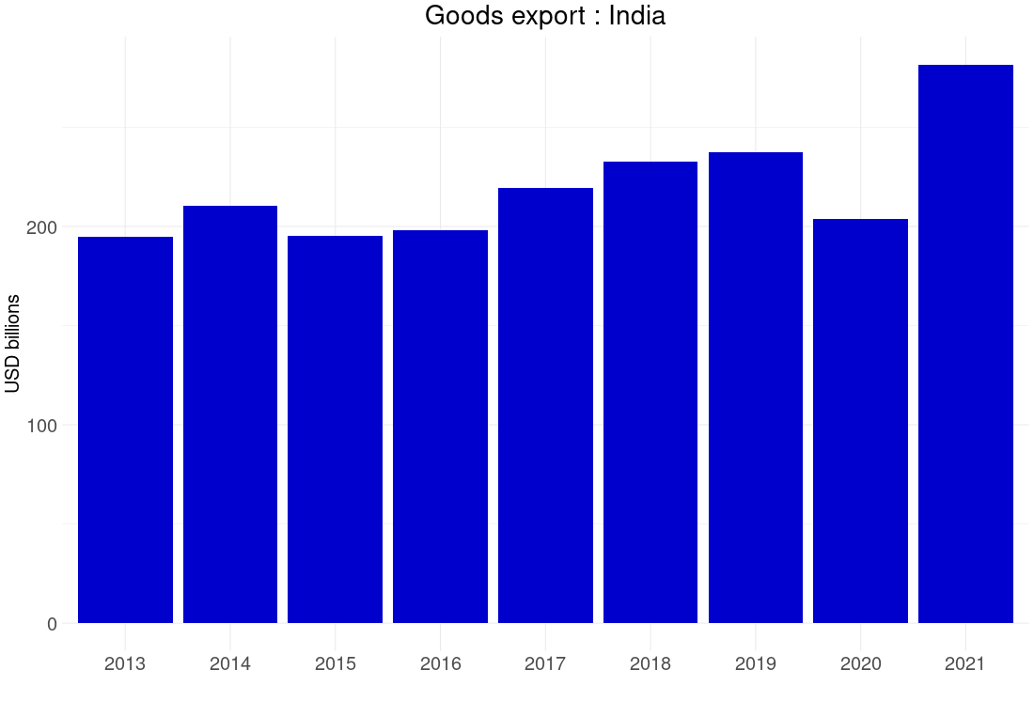
2021: goods exports jumped 38 percent

Slide 39
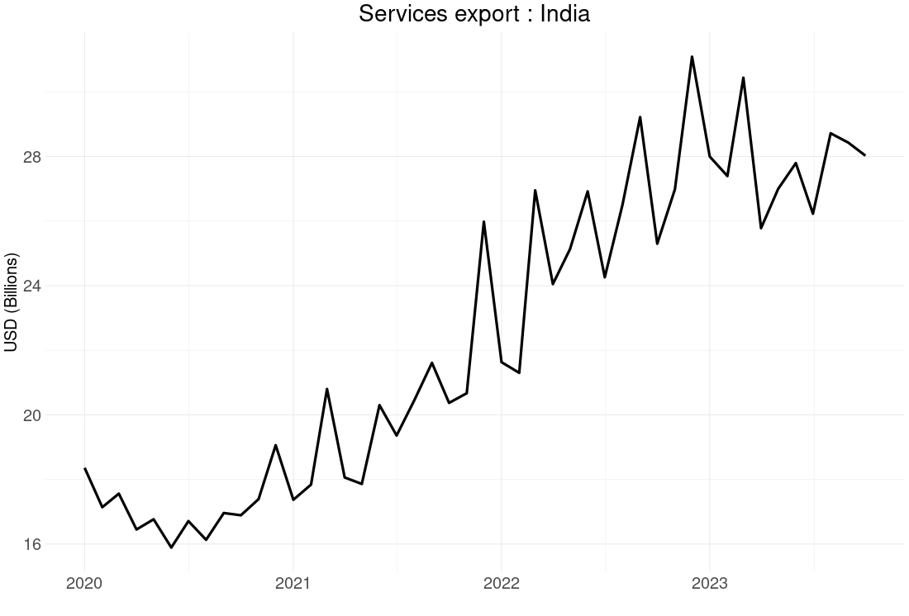
2022: service exports soared 27 percent

Slide 40
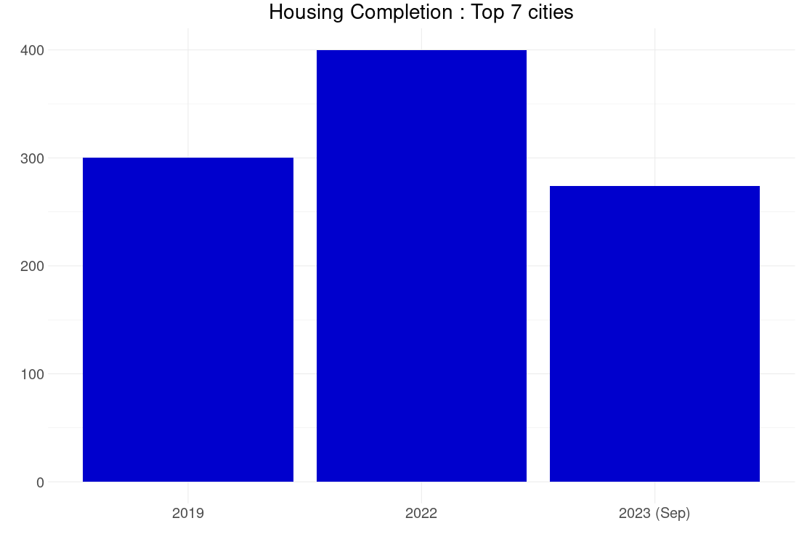
2023: massive housing boom

Slide 41
Resolving the puzzles

Slide 42
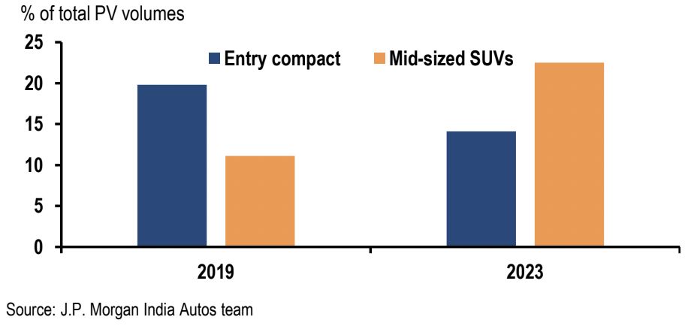
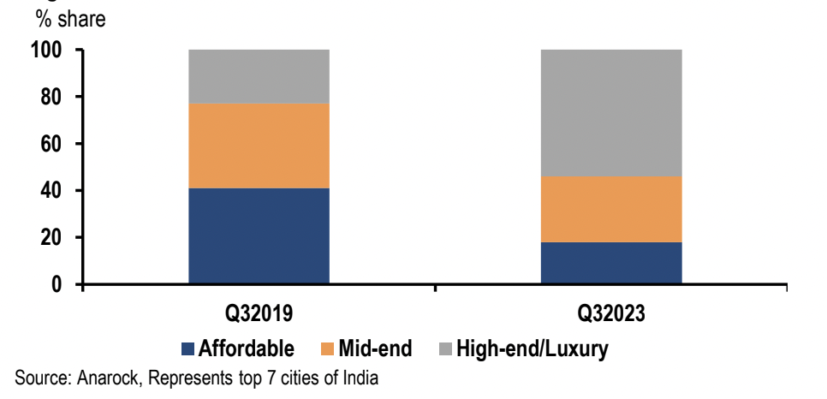
Recovery is K-shaped

Slide 43
Weak services demand

Slide 44
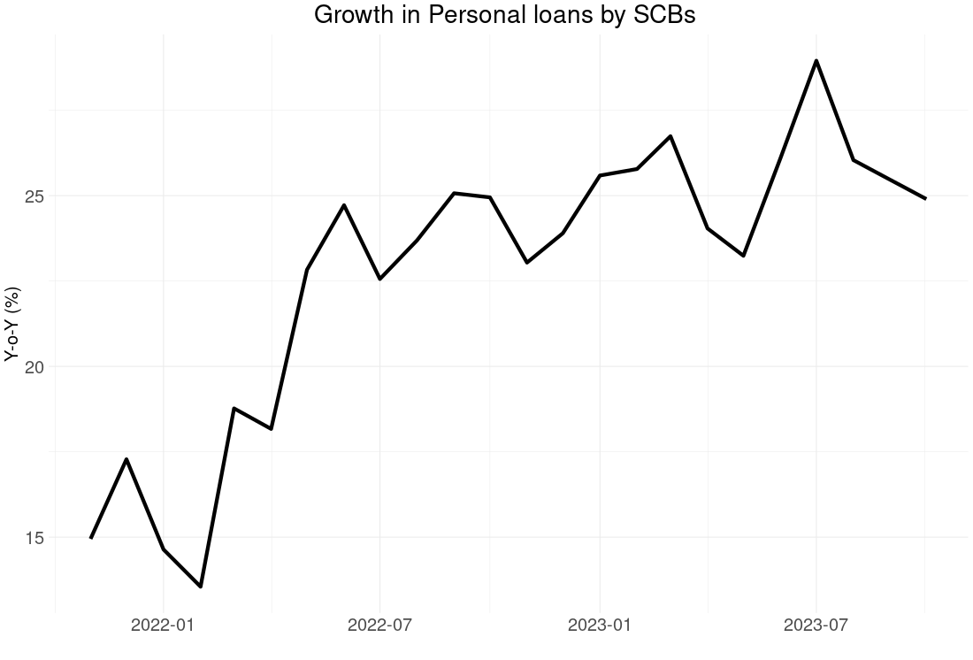
Credit boom

Slide 45
Looking forward
Credit booms don’t last forever
Will recovery broaden?
Keys are investment and exports

Slide 46
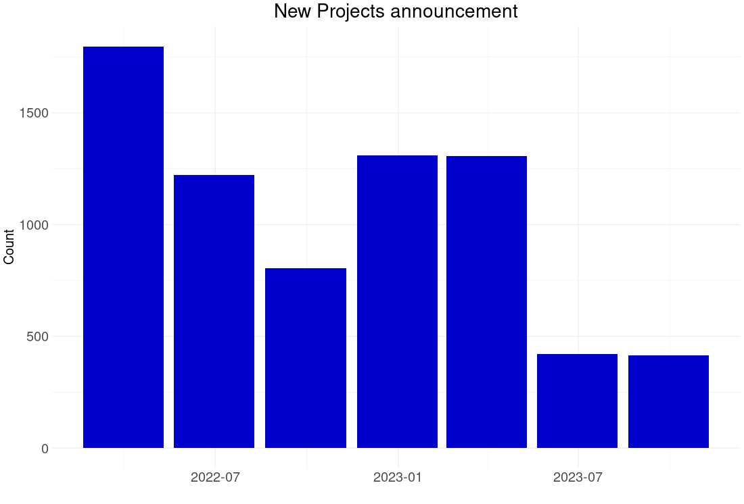
Investment: still in the doldrums

Slide 47
Export booms have subsided

Slide 48
What’s next?
Watch the US
Especially the US labour market

Slide 49
The end!
Josh Felman
JH Consulting
EMC 2023

