Slide 1
Do Investors Pay Less Attention to Women (Fund Managers)?
Raghavendra Rau
University of Cambridge
Jinhua Wang
University of Cambridge

Slide 2
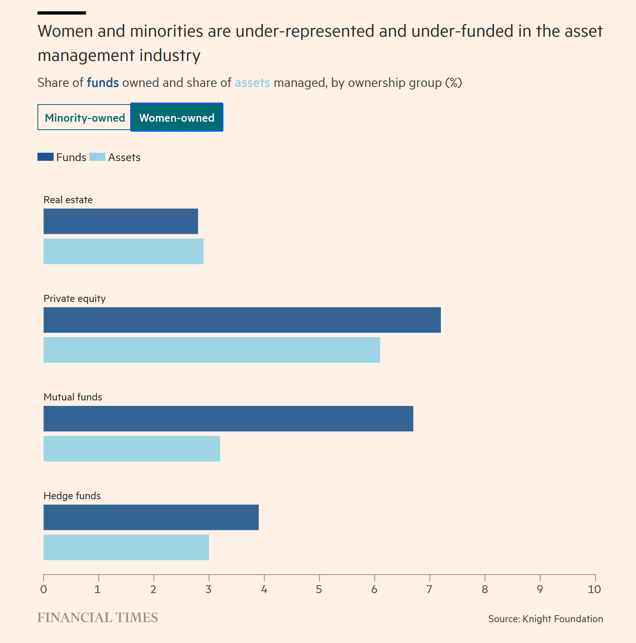
Basic question
Diversity is becoming an increasingly important concern for fund managers and investors.
Does gender bias exist in fund investor’s behaviour?
Yes: Niessen-Ruenzi and Ruenzi (2018) report lower flows to female-managed mutual funds.
What we do: Does gender bias affect the well-documented flow-performance relationship in the mutual fund literature?
Sirri and Tufano (1998) document a positive correlation between prior month’s mutual fund performance and subsequent fund flow.
Is the flow-performance relationship different between male- and female-managed funds?

Slide 3
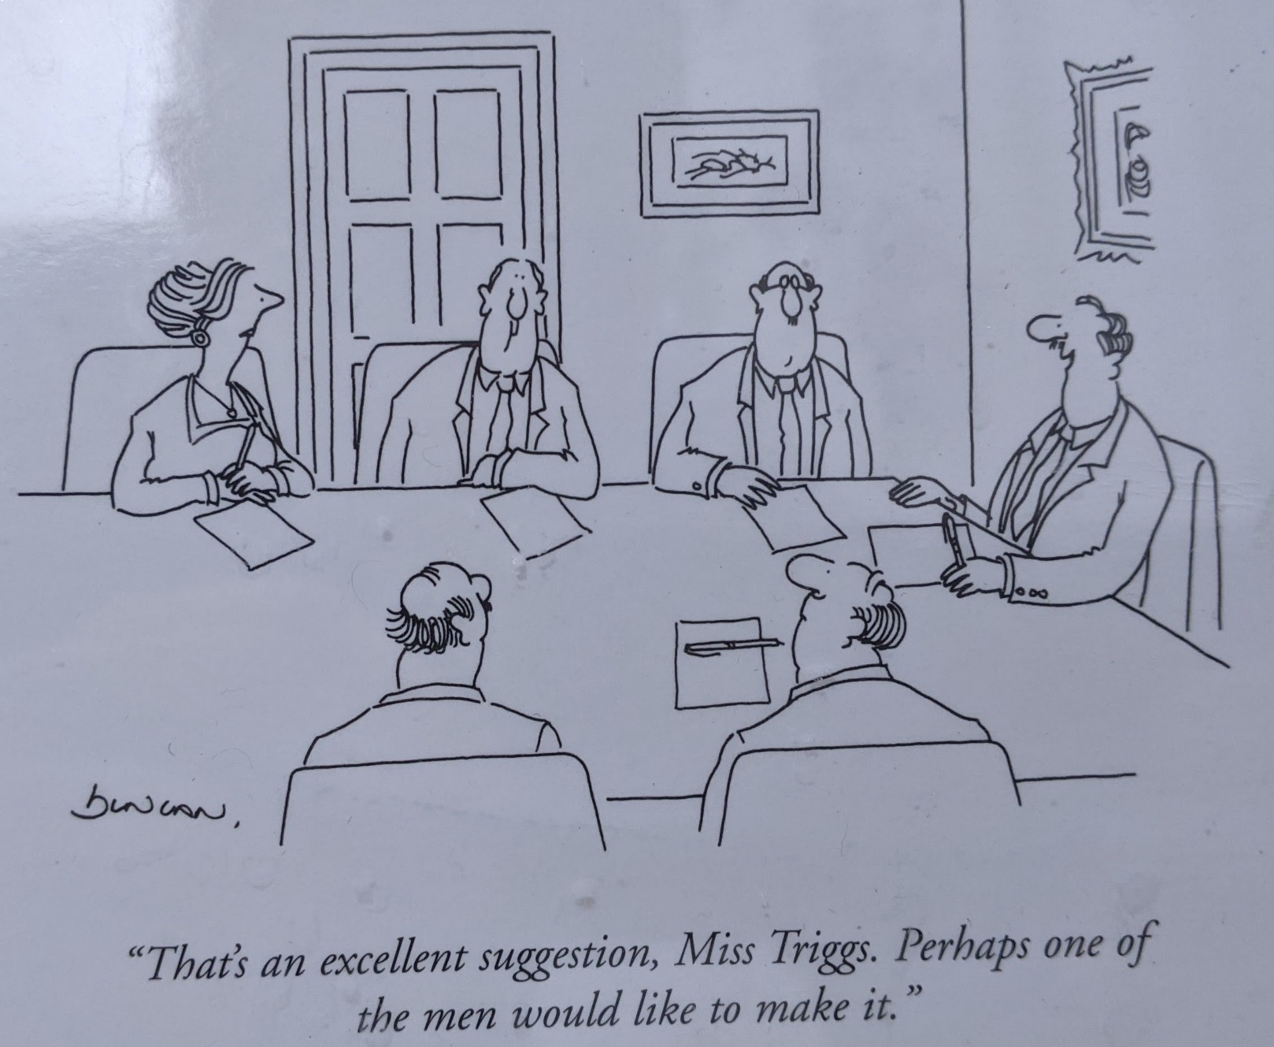
Why is this important?
Examining gender bias towards women is tough in finance because it is difficult to establish how much the output is dependent on the individual executive.
In single-managed mutual funds, it is pretty easy to attribute performance to managerial efforts.
But:
We can’t check if investor fund flows are affected by a gender bias because we don’t have data on investor-level fund flows.
So the flow-performance literature typically focuses on aggregate level fund-level flows, making it difficult to isolate individual investors’ differential responses towards fund managers’ gender.
In this paper, we document a gender effect in the sensitivity of mutual fund flows to fund performance using individual-level fund data from a fintech platform in China.

Slide 4
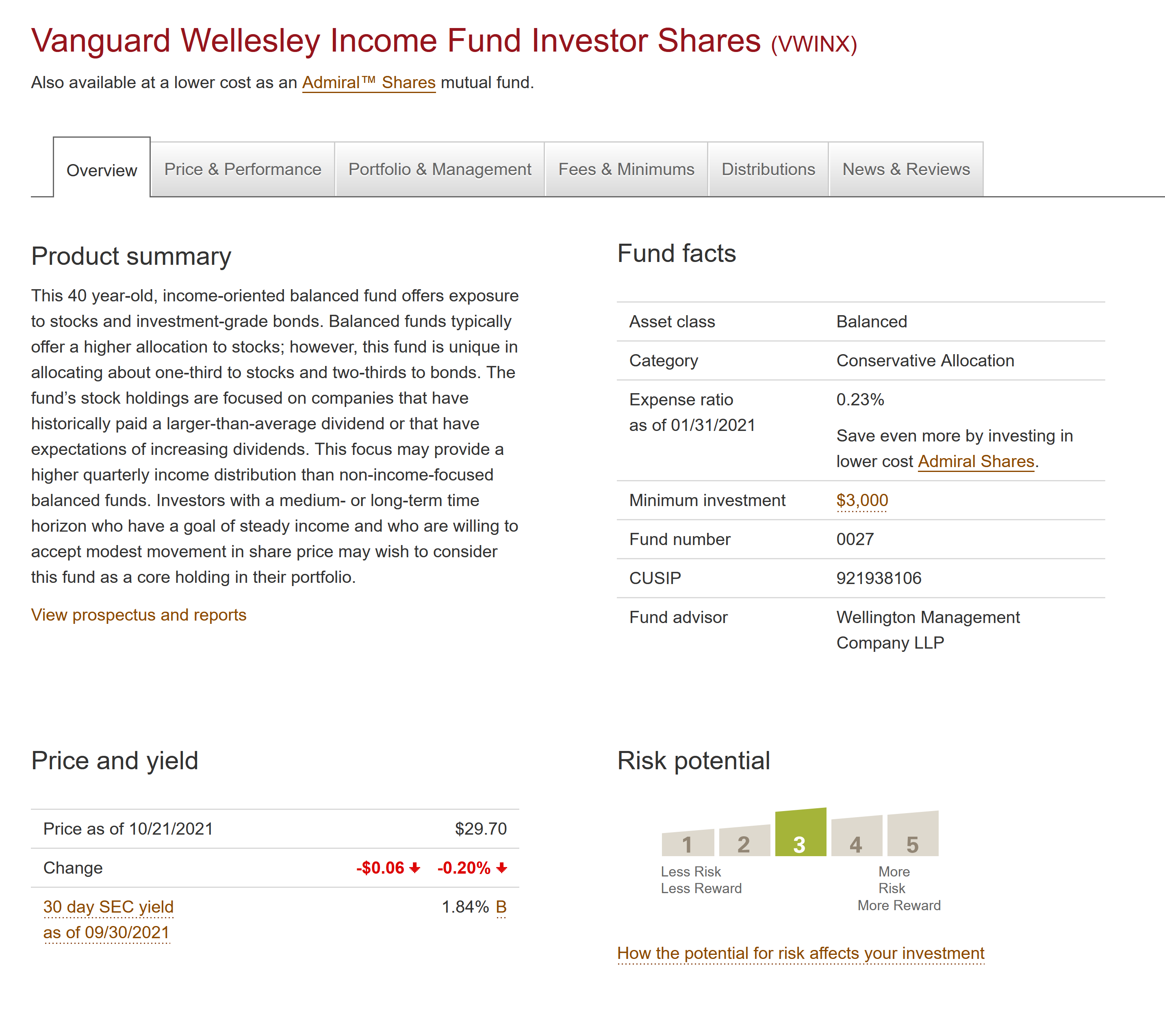
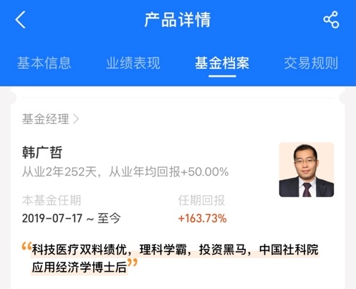
Who cares?
Isn’t this just a minor variation on the question addressed by Niessen-Ruenzi and Ruenzi (2018)?
The problem in all mutual fund studies is that it is not obvious that investors consider gender in their investment decisions.
Niessen-Ruenzi and Ruenzi (2018) report lower aggregate flows to female-managed mutual funds – but we don’t really know that individual investors even know the gender of their fund manager.

Slide 5
Why might investors pay more attention to male managers?
Boys and girls in families receive different levels of attention, especially in developing countries.
Park and Rukumnuaykit (2004) show that rural fathers, especially less educated men, favour sons while rural mothers do not
Gender stereotypes in households and corporations:
Hannum, Kong, and Zhang (2009): Survey data shows that nearly one in five mothers do not expect girls to go to school in rural China, and parents view boys as having greater talent than girls.
Neumark and Bank (1996): Men and women are treated differently in job applications and women are less likely to be hired.
Gender-based double standards:
Botelho and Gertsberg (2020): Quasi-natural experiment to show that women are disadvantaged in the interview process and are given lower ratings on Yelp.

Slide 6
What do we find?
Even when we look at individual level flows, investors chase performance
Investors are biased away from women at the individual level
But there is also a gender-based attention effect in the sensitivity of mutual fund flows to fund performance.
Investors increase (decrease) flows to funds following positive (negative) prior- month performance.
However, although there is no significant difference in the performance of male and female managers, the sensitivity effect significantly weakens if the fund manager is female.
The bias translates to a difference of US$0.36 million in the monthly fund-level performance-flow relationship between male and female managers.
We establish a causal effect of the gender bias using instrumental variables from the Chinese census 2010.

Slide 7
Data
Our sample consists of two main databases supplied by a Fintech platform in China.
The first database documents monthly investment positions in 253 stock funds for 172,672 retail investors on the platform over the period from August 2017 to July 2019.
The second database documents individual characteristics of each investor on the platform, such as their gender, age, monthly payment amount, place of residency and risk tolerance levels.
The CSMAR database documents the fund managers’ characteristics, such as managers’ gender, tenure and education. The database also includes fund characteristics, such as performance metrics and fund sizes.
Final sample: 2.2 million user-fund-month observations.

Slide 8
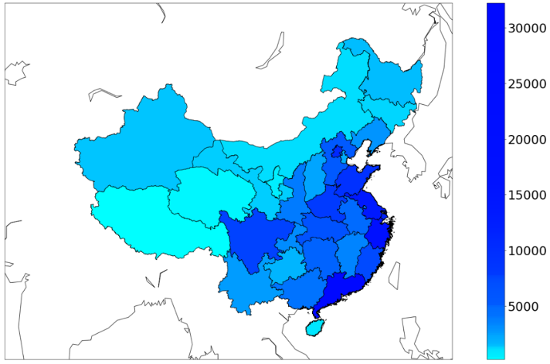
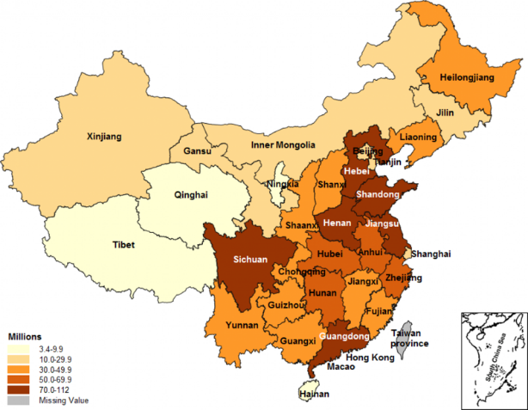
Data
Geographic distribution of the number of stock fund users in mainland China
Geographic distribution of the population in China

Slide 9
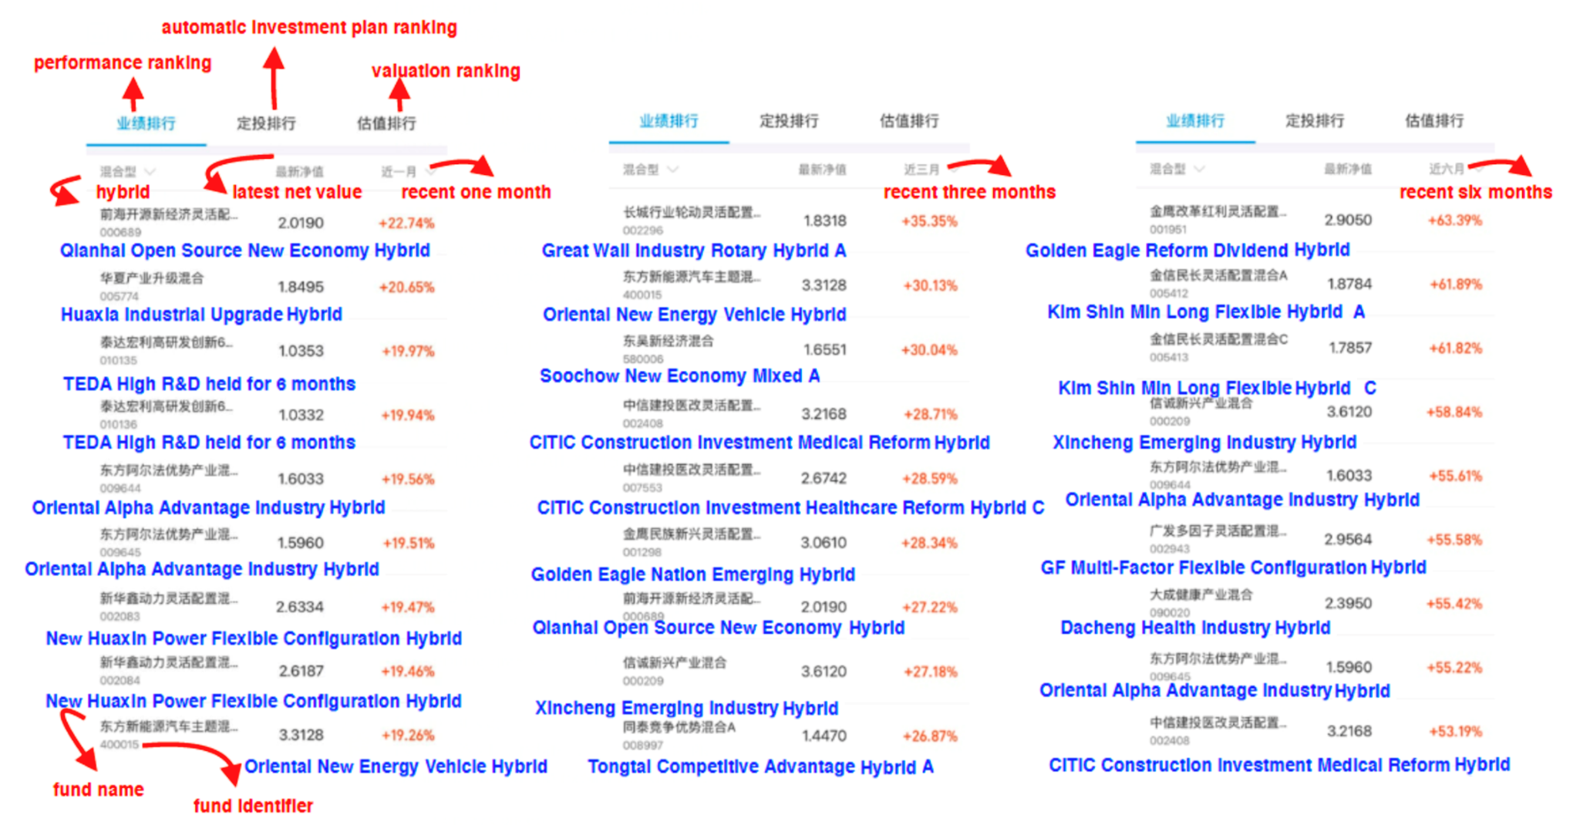
What does the app look like?
1 month return ranking
3 month return ranking
6 month return ranking

Slide 10
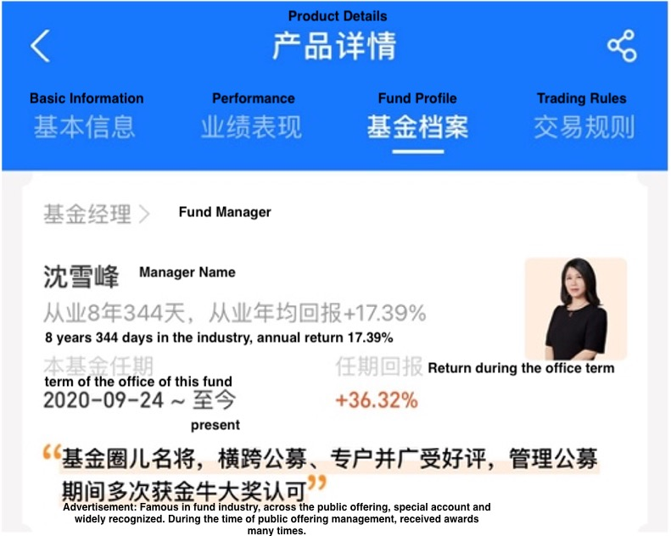
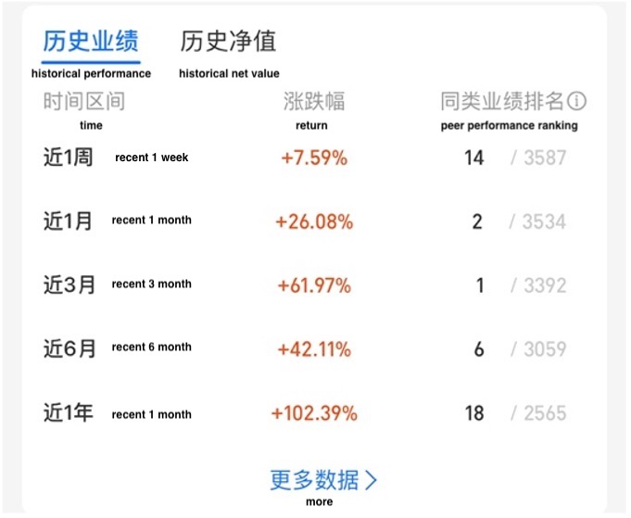
Fund manager information
Ranking of the historical performance of the fund on the platform by 1-, 3-6-, and 12-month returns

Slide 11
Our variables and regression methodology
Fund flow:
Fund monthly return:
Panel OLS
Dummy variable = 1 if the manager is female
`Manager controls
Fund characteristics, user fixed effects, time fixed effects.

Slide 12
What do the funds and managers look like?
 | Entire sample |  |  | Male Managers |  |  | Female Managers |  |  | Two Sample T-test
 | N (Fund-Months) = 3,515 |  |  | N (Fund-Months) = 2,924 |  |  | N (Fund-Month) = 591
Variable | Mean | Std. Dev. |  | Mean | Std. Dev. |  | Mean | Std. Dev. |  | p-value
Fund 1-month NAV return rank | 0.51 | 0.29 |  | 0.50 | 0.29 |  | 0.53 | 0.27 |  | 0.02
Fund 3-month NAV return rank | 0.51 | 0.29 |  | 0.50 | 0.29 |  | 0.54 | 0.28 |  | 0.01
Fund 6-month NAV return rank | 0.51 | 0.29 |  | 0.50 | 0.29 |  | 0.54 | 0.29 |  | 0.00
Fund 12-month NAV return rank | 0.51 | 0.29 |  | 0.49 | 0.29 |  | 0.56 | 0.29 |  | 0.00
Fund Flow | 0.67 | 10.64 |  | 0.69 | 10.81 |  | 0.50 | 9.12 |  | 0.00
Fund TNA (thousands CNY) | 981,601.40 | 1,388,371.00 |  | 1,022,803.00 | 1,462,619.00 |  | 777,752.60 | 912,182.50 |  | 0.00
Fund age (Months) | 41.15 | 20.26 |  | 40.98 | 18.59 |  | 41.99 | 27.05 |  | 0.27
Manager tenure (in years) | 2.12 | 1.35 |  | 2.19 | 1.38 |  | 1.70 | 1.08 |  | 0.00
Sales fee | 0.01% | 0.00 |  | 0.01% | 0.00 |  | 0.02% | 0.00 |  | 0.00
Management fee | 1.69% | 0.01 |  | 1.71% | 0.01 |  | 1.57% | 0.00 |  | 0.00
Transaction fee | 1.04% | 0.01 |  | 1.07% | 0.01 |  | 0.89% | 0.01 |  | 0.00
Media mention frequency (rank) | 0.11 | 0.28 |  | 0.11 | 0.28 |  | 0.08 | 0.23 |  | 0.00
Positive mention frequency rank | 0.10 | 0.27 |  | 0.11 | 0.28 |  | 0.08 | 0.23 |  | 0.01
Negative mention frequency rank | 0.03 | 0.14 |  | 0.04 | 0.15 |  | 0.02 | 0.09 |  | 0.01
 | Entire sample |  | Male Managers |  | Female Managers
Variable | Fund-Month Count |  | Fund-Month Count |  | Fund-Month Count
Manager Degree - Undergraduate | 86 |  | 86 |  | 0
Manager Degree - Master | 3,459 |  | 2,924 |  | 535
Manager Degree - MBA / EMBA | 36 |  | 36 |  | 0
Manager Degree - Doctoral | 331 |  | 265 |  | 66
Female managers perform
significantly better.
Female managers have higher sales fees but lower management and transaction fees. They have lower tenures and are not mentioned in the news
Female managers are better qualified than male managers

Slide 13
What do the users look like? Univariate statistics
 | Entire sample |  |  | Male Users |  |  | Female Users |  |  | Two Sample T-test
 | N (User-Months) = 2,345,875 |  |  | N (User-Months) = 2,090,157 |  |  | N (User-Months) = 255,718
Variable | Mean | Std. Dev. |  | Mean | Std. Dev. |  | Mean | Std. Dev. |  | p-value
Fund Amount | 5,893.31 | 24,928.60 |  | 5,963.80 | 25,308.92 |  | 5,317.15 | 21,561.50 |  | 0.00
Fund Flow | 0.67 | 10.66 |  | 0.69 | 10.83 |  | 0.51 | 9.13 |  | 0.00
User Monthly Capital Gain/Loss (CNY) | -3.94 | 1,546.76 |  | -4.01 | 1,575.02 |  | -3.36 | 1,292.82 |  | 0.84
User Monthly Spending Amount (thousands CNY) | 5.30 | 20.07 |  | 5.31 | 20.39 |  | 5.27 | 17.20 |  | 0.33
User Age | 32.40 | 8.31 |  | 32.41 | 8.32 |  | 32.36 | 8.22 |  | 0.01
User City Size | 2.43 | 1.25 |  | 2.43 | 1.25 |  | 2.44 | 1.26 |  | 0.00
User Risk Tolerance | 3.16 | 1.06 |  | 3.16 | 1.06 |  | 3.19 | 1.06 |  | 0.00
Male investors save
more than female investors.
Female investors are more risk tolerant (less risk averse).

Slide 14
Is there a fund flow-performance relation in China?
 | Lagged alternative performance measures (Independent Variables) Return ranking over
 | 1-month | 1-month | 3-month | 6-month | 12-month
 | (1) | (2) | (3) | (4) | (5)
Fund performance
Fund performance ranking | 0.3562 *** | 0.3559 *** | 0.4589 *** | 0.4881 *** | 0.2652 ***
 | (0.0251) | (0.0251) | (0.0262) | (0.0286) | (0.0302)
Managerial characteristics
Manager gender (Female) |  | 0.0296 | 0.0142 | -0.0078 | 0.0186
 |  | (0.0284) | (0.0284) | (0.0285) | (0.0294)
Manager tenure | 0.0447 *** | 0.0464 *** | 0.0443 *** | 0.0386 *** | 0.0406 ***
 | (0.0066) | (0.0070) | (0.0070) | (0.0070) | (0.0071)
Fund characteristics
Fund risk (Previous month) | 0.3588 *** | 0.3596 *** | 0.3714 *** | 0.3567 *** | 0.4490 ***
 | (0.0314) | (0.0314) | (0.0312) | (0.0314) | (0.0329)
Log(Fund age) | 0.0245 | 0.0182 | 0.0257 | 0.0388 | 0.0355
 | (0.0282) | (0.0292) | (0.0292) | (0.0295) | (0.0334)
Log(TNA) (previous quarter) | 0.0504 *** | 0.0521 *** | 0.0530 *** | 0.0386 *** | 0.0303 ***
 | (0.0092) | (0.0092) | (0.0092) | (0.0092) | (0.0095)
Aggregate fund flow (previous quarter) | -0.0214 *** | -0.0214 *** | -0.0244 *** | -0.0296 *** | 0.0133
 | (0.0038) | (0.0038) | (0.0037) | (0.0038) | (0.0120)
Fund sales fee (%) | 0.7368 *** | 0.7478 *** | 0.8423 *** | 0.7666 *** | 0.8080 ***
 | (0.2529) | (0.2529) | (0.2523) | (0.2539) | (0.2689)
Fund management fee (%) | -0.1928 *** | -0.1944 *** | -0.1535 *** | -0.1338 *** | -0.1659 ***
 | (0.0199) | (0.0199) | (0.0202) | (0.0202) | (0.0207)
Fund transaction fee (%) | -0.0220 | -0.0208 | -0.0246 | -0.0179 | -0.0186
 | (0.0166) | (0.0167) | (0.0167) | (0.0167) | (0.0171)
User income
Rolling average spending in prior 6 months | 0.0027 | 0.0027 | 0.0027 | 0.0026 | 0.0028
(thousands CNY) | (0.0030) | (0.0030) | (0.0030) | (0.0030) | (0.0031)
Std dev of rolling spending levels in prior 6 | -0.0024 | -0.0024 | -0.0024 | -0.0024 | -0.0024
months (thousands CNY) | (0.0020) | (0.0020) | (0.0020) | (0.0020) | (0.0021)
Current month spending (thousands CNY) | -0.0013 *** | -0.0013 *** | -0.0013 *** | -0.0013 *** | -0.0011 ***
 | (0.0004) | (0.0004) | (0.0004) | (0.0004) | (0.0004)
Positive performance-flow relationship
No significant difference in the absolute level of fund flows between male and female managers.
Fixed Effects: Month, User, Manager Degree, Fund Objective
Standard Error Clustering: User

Slide 15
Is there an aggregate fund flow-performance relation in China?
 | Dependent Variable
 | Quarterly Level Fund Flow
 | (1)
Fund performance
Fund previous quarter return ranking | 0.1301***
 | (0.0303)
Managerial characteristics
Manager gender (Female) | -0.0680
 | (0.0989)
Manager tenure | 0.0122
 | (0.0117)
Fund characteristics
Fund risk (Previous month) | 0.1951***
 | (0.0700)
Log(TNA) (previous quarter) | -0.3369***
 | (0.0722)
Aggregate fund flow (previous quarter) | -0.0017
 | (0.0575)
Fund sales fee (%) | -1.8038***
 | (0.6228)
Fund management fee (%) | -0.0228***
 | (0.0077)
Fund transaction fee (%) | -0.0456***
 | (0.0173)
Fixed Effects
Month | TRUE
Fund | TRUE
Manager Degree | TRUE
Standard Error Clustering
Fund | TRUE
Base Dummy Variables
Gender | Male
R² (Within) | 0.1258
N | 2,005
Positive performance-flow relationship
No significant difference in the absolute level of fund flows between male and female managers.

Slide 16
Is there a gender bias in China at the individual investor level?
 | (1) | (2)
Fund performance
Fund prior 1-month NAV return rank | -0.3347 *** | -0.4617 ***
 | (0.0290) | (0.0380)
Managerial characteristics
Manager tenure |  | -0.7833 ***
 |  | (0.0110)
Fund characteristics
Fund risk (Previous month) |  | -0.0722 ***
 |  | (0.0220)
Log(Fund age) |  | 0.4525 ***
 |  | (0.0400)
Log(TNA) (previous quarter) |  | -0.2684 ***
 |  | (0.0090)
Aggregate fund flow (previous quarter) |  | -0.2868 ***
 |  | (0.0130)
Fund sales fee (%) |  | -1.1532 **
 |  | (0.5496)
Fund management fee (%) |  | 0.3031 ***
 |  | (0.0228)
Fund transaction fee (%) |  | -1.6371 ***
 |  | (0.0505)
User characteristics
User age | -0.0038 *** | -0.0034 **
 | (0.0010) | (0.0010)
User city tier | 0.0186 ** | 0.0300 ***
 | (0.0070) | (0.0080)
User risk band | -0.0139 | -0.0166
 | (0.0090) | (0.0100)
User gender | -0.0342 * | -0.0218
 | (0.0200) | (0.0220)
Fintech platform income (High) | -0.0227 | -0.031
 | (0.0290) | (0.0320)
Fintech platform income (Low) | 0.1041 | 0.1135
 | (0.0780) | (0.0830)
Rolling average spending in prior 6 months (thousands CNY) | -0.0023 | -0.0018
 | (0.0020) | (0.0020)
Std dev of rolling spending levels in prior 6 months (thousands CNY) | 0.0014 | 0.001
 | (0.0010) | (0.0020)
Current month spending (thousands CNY) | -0.0017 * | -0.0016 *
 | (0.0010) | (0.0010)
Pseudo R² | 0.07929 | 0.2045
N | 142,587 | 139,565
Probit regression for the first-time investors.
For the same level of performance, first-time investors are less likely to invest in female managers.

Slide 17
Do investors pay less attention to women fund managers?
 | Lagged alternative performance measures (Independent Variables) Return ranking over
 | 1-month | 3-month | 6-month | 12-month
 | (1) | (2) | (3) | (4)
Fund performance
Fund performance ranking | 0.3860 *** | 0.4816 *** | 0.5178 *** | 0.2872 ***
 | (0.0263) | (0.0274) | (0.0302) | (0.0317)
Fund Performance × Manager gender (Female) | -0.3258 *** | -0.2520 *** | -0.2642 *** | -0.2013 ***
 | (0.0781) | (0.0711) | (0.0703) | (0.0724)
Managerial characteristics
Manager gender (Female) | 0.2062 *** | 0.1617 *** | 0.1626 *** | 0.1587 ***
 | (0.0472) | (0.0459) | (0.0463) | (0.0520)
Manager tenure | 0.0465 *** | 0.0441 *** | 0.0383 *** | 0.0403 ***
 | (0.0070) | (0.0070) | (0.0070) | (0.0071)
Fund characteristics
Fund risk (Previous month) | 0.3543 *** | 0.3693 *** | 0.3560 *** | 0.4482 ***
 | (0.0313) | (0.0312) | (0.0314) | (0.0329)
Log(Fund age) | 0.0173 | 0.0229 | 0.0301 | 0.0234
 | (0.0292) | (0.0292) | (0.0294) | (0.0335)
Log(TNA) (previous quarter) | 0.0523 *** | 0.0533 *** | 0.0399 *** | 0.0315 ***
 | (0.0092) | (0.0092) | (0.0093) | (0.0095)
Aggregate fund flow (previous quarter) | -0.0213 *** | -0.0247 *** | -0.0302 *** | 0.0126
 | (0.0038) | (0.0037) | (0.0038) | (0.0120)
Fund sales fee (%) | 0.7621 *** | 0.8627 *** | 0.7912 *** | 0.8129 ***
 | (0.2530) | (0.2521) | (0.2539) | (0.2688)
Fund management fee (%) | -0.1963 *** | -0.1562 *** | -0.1379 *** | -0.1642 ***
 | (0.0199) | (0.0201) | (0.0203) | (0.0207)
Fund transaction fee (%) | -0.0258 | -0.0294 * | -2.1647 | -2.2535
 | (0.0167) | (0.0167) | (0.0167) | (0.0171)
User income
Rolling average spending in prior 6 months (thousands CNY) | 0.0027 | 0.0027 | 0.0027 | 0.0028
 | (0.0030) | (0.0030) | (0.0030) | (0.0031)
Std dev of rolling spending levels in prior 6 months (thousands CNY) | -0.0024 | -0.0024 | -0.0024 | -0.0024
 | (0.0020) | (0.0020) | (0.0020) | (0.0021)
Current month spending (thousands CNY) | -0.0013 *** | -0.0013 *** | -0.0013 *** | -0.0011 ***
 | (0.0004) | (0.0004) | (0.0004) | (0.0004)
Weaker performance-flow relationship for female-managed funds

Slide 18
Is past performance a better predictor for male managers?
 | Dependent Variables
 | Future 3-month return rank | Future 6-month return rank | Future 12-month return rank
 | (1) | (2) | (3)
Manager gender (Female) | 0.0435 | 0.0256 | -0.0184
 | (0.0464) | (0.0496) | (0.0625)
Fund current 1-month NAV return rank | -0.0303** | -0.0268** | -0.0496***
 | (0.0126) | (0.0111) | (0.0096)
Fund current 1-month NAV return rank × Manager | 0.0213 | 0.0068 | 0.0055
gender (Female) | (0.0307) | (0.0278) | (0.0209)
Fund Level Flow (Current Quarter) | 0.0245* | 0.0279* | 0.038***
 | (0.0142) | (0.0161) | (0.0142)
Manager tenure | -0.0235*** | -0.02* | -0.0053
 | (0.0078) | (0.0118) | (0.0161)
Fund risk (Current month) | -0.1372*** | -0.1141*** | -0.1035***
 | (0.0232) | (0.0256) | (0.0252)
Log(TNA) | -0.0594*** | -0.1066*** | -0.1329***
 | (0.0196) | (0.0230) | (0.0234)
Fund sales fee (%) | 0.0172 | -0.3700 | -0.2334
 | (0.3206) | (0.3185) | (0.2418)
Fund management fee (%) | -0.0146*** | -0.0154*** | -0.006491
 | (0.0050) | (0.0059) | (0.0050)
Fund transaction fee (%) | -0.0294*** | -0.0362*** | -0.0291**
 | (0.0098) | (0.0125) | (0.0117)
R² (Within) | 0.0061 | 0.0423 | 0.0628
N | 7,252 | 7,250 | 7,029
Inconsistent with the hypothesis that Chinese mutual fund managers have hot hands.
There is no evidence that male managers are more likely to have hot hands than female managers.

Slide 19
Is there an asymmetric attention bias response?
 | Subsamples
 | Winners | Losers | All Funds
 | (1) | (2) | (3)
Fund performance
Fund performance ranking | 0.8146 *** | 0.2798 *** | 0.2872 ***
 | (0.0783) | (0.0305) | (0.0299)
Fund Performance × Manager gender (Female) | -0.7842 *** | -0.1926 ** | -0.2014 **
 | (0.1822) | (0.0952) | (0.0937)
Return increase dummy |  |  | -0.1406 ***
 |  |  | (0.0327)
Return increase dummy × Manager gender (Female) |  |  | 0.2157 **
 |  |  | (0.0957)
Return increase dummy × Fund performance ranking |  |  | 0.4819 ***
 |  |  | (0.0663)
Return increase dummy × Manager gender (Female) × |  |  | -0.5453 ***
Fund performance ranking |  |  | (0.1761)
Managerial characteristics
Manager gender (Female) | 0.5110 *** | 0.1331 ** | 0.1560 ***
 | (0.1076) | (0.0559) | (0.0543)
Manager tenure | 0.0638 *** | 0.0365 *** | 0.0458 ***
 | (0.0169) | (0.0083) | (0.0070)
Fund characteristics
Fund risk (Previous month) | 0.2717 *** | 0.4365 *** | 0.3609 ***
 | (0.0747) | (0.0382) | (0.0314)
Log(Fund age) | -0.1323 * | 0.0397 | 0.0061
 | (0.0736) | (0.0337) | (0.0291)
Log(TNA) (previous quarter) | 0.0869 *** | 0.0516 *** | 0.0569 ***
 | (0.0232) | (0.0107) | (0.0092)
Aggregate fund flow (previous quarter) | -0.0255 ** | -0.0109 ** | -0.0181 ***
 | (0.0099) | (0.0043) | (0.0037)
Fund sales fee (%) | 0.91315 | 0.8585 *** | 0.7888 ***
 | (0.5708) | (0.3087) | (0.2525)
Fund management fee (%) | -0.2671 *** | -0.1473 *** | -0.1814 ***
 | (0.0528) | (0.0227) | (0.0198)
Fund transaction fee (%) | -0.027151 | -0.014163 | -0.0362 **
 | (0.0402) | (0.0199) | (0.0168)
User income
Rolling average spending in prior 6 months (thousands CNY) | 0.0072 | 0.0017 | 0.0027
 | (0.0097) | (0.0024) | (0.0030)
Std dev of rolling spending levels in prior 6 months (thousands CNY) | -0.0065 | -0.0015 | -0.0024
 | (0.0068) | (0.0015) | (0.0020)
Current month spending (thousands CNY) | -0.0028 ** | -0.0008 * | -0.0013 ***
 | (0.0012) | (0.0004) | (0.0004)
R² (Within) | 0.0012 | 0.0002 | 0.0003
N | 588,136 | 1,752,974 | 2,272,010
Funds whose returns have increased in the previous month relative to the prior two months.
 | Subsamples
 | Winners | Losers | All Funds
 | (1) | (2) | (3)
Fund performance
Fund performance ranking | 0.8146 *** | 0.2798 *** | 0.2872 ***
 | (0.0783) | (0.0305) | (0.0299)
Fund Performance × Manager gender (Female) | -0.7842 *** | -0.1926 ** | -0.2014 **
 | (0.1822) | (0.0952) | (0.0937)
Return increase dummy |  |  | -0.1406 ***
 |  |  | (0.0327)
Return increase dummy × Manager gender (Female) |  |  | 0.2157 **
 |  |  | (0.0957)
Return increase dummy × Fund performance ranking |  |  | 0.4819 ***
 |  |  | (0.0663)
Return increase dummy × Manager gender (Female) × |  |  | -0.5453 ***
Fund performance ranking |  |  | (0.1761)
Managerial characteristics
Manager gender (Female) | 0.5110 *** | 0.1331 ** | 0.1560 ***
 | (0.1076) | (0.0559) | (0.0543)
Manager tenure | 0.0638 *** | 0.0365 *** | 0.0458 ***
 | (0.0169) | (0.0083) | (0.0070)
R² (Within) | 0.0012 | 0.0002 | 0.0003
N | 588,136 | 1,752,974 | 2,272,010
The differential flow-performance sensitivity for male- and female-managed funds is worse for winners than losers

Slide 20
Maybe men are more noisy about effort?
Perhaps men just have very noisy signals about effort. So you really need to see their performance before investing
Women are transparent about effort. So you don’t need to be sensitive to performance – you know they are working hard.

Slide 21
Do male fund managers deliver better performance?
 | Dependent Variables
 | 1-month return ranking | 3-month return ranking | 6-month return ranking | 12-month return ranking | Return Std. Dev. | Sharpe Ratio | CAPM Beta | CAPM Alpha
 | (1) | (2) | (3) | (4) | (5) | (6) | (7) | (8)
Manager gender (Female) | 0.0424* | 0.0767 | 0.0449 | -0.0351 | -0.0701 | 0.0099 | -0.0212 | -0.0017
 | (0.0239) | (0.0493) | (0.0647) | (0.0722) | (0.0812) | (0.0161) | (0.0721) | (0.0158)
Log(TNA) (previous quarter) | -0.0517*** | -0.0796*** | -0.0476*** | 0.035 | 0.0262 | -0.0222*** | 0.0364 | -0.0314***
 | (0.0143) | (0.0178) | (0.0166) | (0.0260) | (0.0319) | (0.0085) | (0.0288) | (0.0080)
Aggregate fund flow (previous quarter) | -0.0014 | 0.0255* | 0.0913*** | 0.0618*** | 0.0187 | 0.0018 | -0.0196 | -0.0036
 | (0.0118) | (0.0155) | (0.0176) | (0.0174) | (0.0177) | (0.0065) | (0.0160) | (0.0060)
Manager tenure | -0.0182*** | -0.0252*** | -0.0322*** | -0.0384*** | 0.0081 | -0.0115*** | -0.0052 | -0.0099***
 | (0.0051) | (0.0072) | (0.0094) | (0.0114) | (0.0091) | (0.0022) | (0.0081) | (0.0026)
Fund risk (Previous Month) | -0.0653*** | 0.0314 | 0.0995*** | 0.1686***
 | (0.0189) | (0.0247) | (0.0235) | (0.0267)
Fund sales fee (%) | 0.338597 | 0.010095 | -0.422233 | 0.247107 | 0.316774 | 0.158524 | 0.1126 | 0.26023
 | (0.2839) | (0.3673) | (0.3607) | (0.5159) | (0.6907) | (0.2572) | (0.4702) | (0.2181)
Fund management fee (%) | -0.0083* | -0.0165*** | -0.0185*** | -0.0758** | -0.003582 | 0.0069** | -0.0112*** | -0.003043
 | (0.0050) | (0.0064) | (0.0068) | (0.0325) | (0.0027) | (0.0032) | (0.0029) | (0.0024)
Fund transaction fee (%) | -0.0214*** | -0.0388*** | -0.0584*** | -0.023901 | 0.01552 | -0.0183*** | 0.0275*** | -0.0167***
 | (0.0082) | (0.0133) | (0.0146) | (0.0208) | (0.0116) | (0.0031) | (0.0104) | (0.0041)
R² (Within) | 0.0094 | 0.0338 | 0.0472 | 0.0203 | -0.0006 | 0.0127 | 0.0174 | 0.0123
N | 6,424 | 6,424 | 6,405 | 5,913 | 6,424 | 6,424 | 6,424 | 6,424
Female managers perform better in terms of 1-month return. No significant difference in performance between male and female managers in other performance measures.

Slide 22
Are male fund managers more skilled?
 | Dependent Variables
 | Treynor Index | TM-Model Market Timing | TM-Model Stock Selection | CL-Model Bear Market Timing | CL-Model Bull Market Timing | CL-Model Market Timing | CL-Model Stock Selection
 | (9) | (10) | (11) | (12) | (13) | (14) | (15)
Manager gender (Female) | 0.6975 | 0.0449 | 0.0108 | -0.0325 | -0.0074 | 0.0251 | 0.0124
 | (0.6593) | (0.0273) | (0.0147) | (0.0913) | (0.0679) | (0.0755) | (0.0202)
Log(TNA) (previous quarter) | -0.1875 | 0.0073 | -0.0332*** | 0.0577* | 0.032 | -0.0257 | -0.0279**
 | (0.1957) | (0.0164) | (0.0091) | (0.0349) | (0.0275) | (0.0326) | (0.0118)
Aggregate fund flow (previous quarter) | -0.0094 | -0.0063 | -0.0117* | -0.0261 | -0.0023 | 0.0238 | -0.0165*
 | (0.0720) | (0.0109) | (0.0070) | (0.0203) | (0.0206) | (0.0250) | (0.0092)
Manager tenure | 0.0594 | -0.0025 | -0.0098*** | -0.0006 | -0.0049 | -0.0043 | -0.0101**
 | (0.0417) | (0.0059) | (0.0028) | (0.0121) | (0.0087) | (0.0134) | (0.0040)
Standardized fund sales fee (%) | 0.940788 | 0.327851 | 0.2527* | -0.09152 | 0.194437 | 0.285952 | 0.268855
 | (2.7052) | (0.2369) | (0.1515) | (0.3778) | (0.6505) | (0.3991) | (0.1636)
Standardized fund management fee (%) | -0.2279*** | -0.006065 | -0.002134 | -0.007477 | -0.0119*** | -0.004459 | -0.0026*
 | (0.0326) | (0.0052) | (0.0016) | (0.0079) | (0.0042) | (0.0115) | (0.0014)
Standardized fund transaction fee (%) | 0.04102 | 0.000956 | -0.0167*** | 0.0430*** | 0.018296 | -0.02473 | -0.0134***
 | (0.0296) | (0.0108) | (0.0041) | (0.0138) | (0.0139) | (0.0174) | (0.0051)
R² (Within) | 0.0339 | 0.0020 | 0.0060 | 0.0153 | 0.0026 | 0.0044 | 0.0010
N | 6,424 | 6,424 | 6,424 | 6,424 | 6,424 | 6,424 | 6,424

Slide 23
Is the attention bias driven by a lack of visibility?
Manager visibility: There are more male managers than female managers. Investors might pay more attention to male managers because of the sheer number of male managers.
Omitted variables bias: Unobservable characteristics that are related both to manager gender and fund flows, such as media attention.

Slide 24
Lack of visibility I: Covariate balance
 | Pre-PSM |  |  |  |  | Post-PSM
 | Male | Female | Difference | Two-sample t-test P-value |  | Male | Female | Difference | Two-sample t-test P-value
Fund performance
Fund prior 1-month NAV return rank | 0.50 | 0.53 | -0.03 | 0.02 |  | 0.55 | 0.53 | 0.02 | 0.31
Fund prior 3-month NAV return rank | 0.50 | 0.53 | -0.03 | 0.01 |  | 0.52 | 0.53 | -0.01 | 0.48
Fund prior 6-month NAV return rank | 0.50 | 0.54 | -0.04 | 0.01 |  | 0.53 | 0.54 | 0.00 | 0.80
Fund prior 12-month NAV return rank | 0.49 | 0.56 | -0.06 | 0.00 |  | 0.56 | 0.56 | 0.00 | 0.79
Fund characteristics
Fund risk (Previous month) | 1.43 | 1.36 | 0.07 | 0.00 |  | 1.37 | 1.36 | 0.02 | 0.47
Log(Fund age) | 3.65 | 3.62 | 0.03 | 0.09 |  | 3.58 | 3.62 | -0.04 | 0.16
Log(TNA) (previous quarter) | 19.89 | 19.60 | 0.30 | 0.00 |  | 19.48 | 19.60 | -0.12 | 0.24
Aggregate fund flow (previous quarter) | 0.03 | 0.08 | -0.05 | 0.25 |  | 0.06 | 0.08 | -0.02 | 0.60
Fund sales fee | 0.01% | 0.02% | 0.00 | 0.00 |  | 0.02% | 0.02% | 0.00 | 0.92
Fund management fee | 1.71% | 1.57% | 0.00 | 0.00 |  | 1.55% | 1.57% | 0.00 | 0.66
Fund transaction fee | 1.07% | 0.89% | 0.00 | 0.00 |  | 0.85% | 0.89% | 0.00 | 0.35
Managerial characteristics
Manager tenure | 2.44 | 1.99 | 0.45 | 0.00 |  | 2.0199 | 1.9889 | 0.03 | 0.66
Undergraduate degree (Count) | 69 | 0 | 69.00 |  |  | 590 | 590 | 0.00
Good covariate balance post-matching.

Slide 25
Lack of visibility I: PSM
Regression estimates (post-matching)
 | Lagged alternative performance measures (Independent Variables)
 | Fund prior 1-month NAV return rank | Fund prior 3-month NAV return rank | Fund prior 6-month NAV return rank | Fund prior 12-month NAV return rank
 | (1) | (2) | (3) | (4)
Fund performance
Fund performance ranking | 0.3721 *** | 0.6278 *** | 0.9451 *** | 0.3145 ***
 | (0.0749) | (0.0877) | (0.1109) | (0.0979)
Fund Performance × Manager gender (Female) | -0.1952 * | -0.3143 *** | -0.5170 *** | -0.2114 *
 | (0.1108) | (0.1164) | (0.1242) | (0.1189)
Managerial characteristics
Manager gender (Female) | 0.0954 | 0.1622 ** | 0.2470 *** | 0.1275
 | (0.0724) | (0.0783) | (0.0806) | (0.0881)
Manager tenure | 0.0815 *** | 0.0784 *** | 0.0621 *** | 0.0824 ***
 | (0.0171) | (0.0173) | (0.0177) | (0.0172)
Attention bias still exists in the matched sample with an equal amount of male and female managers.

Slide 26
Media mentions
Collect approximately 1.2 million Chinese news articles from CSMAR.
Filter out approximately 400,000 news articles within the financial news category.
No plain search of managers’ names in the news articles, as some Chinese names are also common phrases (such as the word “trillion”, which is both the name of a fund manager and an expression of numerical count in Chinese
Use spaCy, a state-of-the art natural-language-processing model based on convolutional neural networks, to extract people’s names from the news articles through part-of-speech tagging and named-entity-recognition.
Count the frequency of each manager’s name in news articles each month and rank the frequency by fund objectives into percentiles.

Slide 27
Gender response to media mentions
 | Lagged alternative performance measures (Independent Variables) Return ranking over
 | 1-month | 1-month | 1-month | 1-month
 | (1) | (2) | (3) | (4)
Media
Media mention frequency rank | 0.2537 ***
 | (0.0269)
Media mention frequency rank × Manager gender | -0.3727 ***
(Female) | (0.0721)
Negative mention frequency rank |  | -0.1867 *** | -0.0871 | -0.0906
 |  | (0.0445) | (0.0608) | (0.0631)
Positive mention frequency rank |  | 0.2366 *** | -0.1292 *** | -0.1431 ***
 |  | (0.0269) | (0.0452) | (0.0466)
Negative mention frequency rank × Fund Performance |  |  | 0.0279 | -0.0133
 |  |  | (0.1519) | (0.1576)
Positive mention frequency rank × Fund Performance |  |  | 0.6780 *** | 0.7766 ***
 |  |  | (0.0824) | (0.0868)
Manager gender (Female) × Negative mention |  |  |  | 0.539
frequency rank × Fund Performance |  |  |  | (0.3970)
Manager gender (Female) × Positive mention |  |  |  | -1.2285 ***
frequency rank × Fund Performance |  |  |  | (0.3128)
Fund performance
Fund performance ranking | 0.3965 *** | 0.3797 *** | 0.2384 *** | 0.2169 ***
 | (0.0265) | (0.0268) | (0.0290) | (0.0292)
Fund Performance × Manager gender (Female) | -0.2920 *** | -0.3206 *** | -0.2700 *** | -0.0367
 | (0.0779) | (0.0781) | (0.0779) | (0.0831)
Managerial characteristics
Manager gender (Female) | 0.2525 *** | 0.2012 *** | 0.1691 *** | 0.1112 **
 | (0.0480) | (0.0471) | (0.0471) | (0.0494)
Manager tenure | 0.0499 *** | 0.0505 *** | 0.0508 *** | 0.0529 ***
 | (0.0070) | (0.0070) | (0.0070) | (0.0070)
Fund and user income controls | YES | YES | YES | YES
R² (Within) | 0.0004 | 0.0004 | 0.0005 | 0.0006
N | 2,272,010 | 2,272,010 | 2,272,010 | 2,272,010
Media mentions increase flow BUT less so for women

Slide 28
Are there cross-sectional differences between investors?
Investor characteristics: User gender, age, city of residency and risk tolerance.
Gender: Lovén, Herlitz, and Rehnman (2011): Women remember more female than male faces, whereas men do not seem to display an own-gender bias in face recognition memory.
Age: Das Gupta and Shuzhuo (1999): Wars and famine experienced in China over the last century led to the prioritization of male children over female children in terms of nutrition and education.
City of residency: In smaller cities or rural areas in developing countries, female children are given less resources and paid less attention in families (e.g., Barcellos, Carvalho, and Lleras-Muney, 2014, Hannum, Kong, and Zhang, 2009, and Park and Rukumnuaykit, 2004). We define big cities as tier-1 cities in China, which include Beijing, Shanghai, Guangzhou and Shenzhen.
Users’ risk tolerance based on a questionnaire on platform: Each user is classified into a risk band, with values ranging from 0 to 6. The smaller the value, the less risk-tolerant the user. We define users with a risk band value below or equal to 2 as risk-averse, and users with a risk band value greater than 2 as risk-tolerant.

Slide 29
Are there cross-sectional differences between investors?
 | User Characteristics (Triple Interaction Variables)
 | (1) | (2) | (3) | (4)
User characteristics
User gender | -0.1966 *** | -0.3200 *** | -0.3200 *** | -0.3222 ***
 | (0.0234) | (0.0162) | (0.0162) | (0.0163)
Fund performance × User gender | -0.2495 ***
 | (0.0458)
Fund performance × User gender × Manager | 0.1319 *
gender (Female) | (0.0696)
User age | 0.0097 *** | 0.0044 *** | 0.0097 *** | 0.0093 ***
 | (0.0011) | (0.0015) | (0.0011) | (0.0011)
Fund performance × User age |  | 0.0105 ***
 |  | (0.0029)
Fund performance × User age × Manager |  | -0.0031
gender (Female) |  | (0.0043)
User city tier | 0.0371 *** | 0.0371 *** | 0.0204 * | 0.0363 ***
 | (0.0070) | (0.0070) | (0.0105) | (0.0070)
Fund performance × User city tier |  |  | 0.0382 *
 |  |  | (0.0199)
Fund performance × User city tier × Manager |  |  | -0.0581 **
gender (Female) |  |  | (0.0285)
User risk band | 0.0075 | 0.0077 | 0.0075 | -0.0044
 | (0.0087) | (0.0087) | (0.0087) | (0.0132)
Fund performance × User risk band |  |  |  | 0.0081
 |  |  |  | (0.0240)
Fund performance × User risk band × Manager |  |  |  | 0.0116
gender (Female) |  |  |  | (0.0354)
Fund performance
Fund performance | 0.4897 *** | 0.0603 | 0.3094 *** | 0.3749 ***
 | (0.0335) | (0.0952) | (0.0525) | (0.0798)
Fund performance × Manager gender | -0.4651 *** | -0.3151 ** | -0.2764 *** | -0.4555 ***
(Female) | (0.0802) | (0.1537) | (0.1009) | (0.1313)
Managerial characteristics
Manager gender (Female) | 0.2861 *** | 0.2837 *** | 0.2847 *** | 0.2861 ***
 | (0.0404) | (0.0404) | (0.0404) | (0.0406)
Manager tenure | 0.0690 *** | 0.0688 *** | 0.0689 *** | 0.0688 ***
 | (0.0057) | (0.0057) | (0.0057) | (0.0057)
Fund and user income controls | YES | YES | YES | YES
R² (Within) | -0.0001 | -0.0001 | -0.0001 | -0.0001
N | 2,268,870 | 2,268,870 | 2,268,870 | 2,258,747

Slide 30
Causality: Instrumental variable I
Proportion of illiterate women in the entire female population at the municipal district level in 2010 based on Census data released by the National Bureau of Statistics of China.
Since the Song Dynasty (960), the Chinese imperial examinations, or Keju, have been used as a civil service examination system for selecting candidates for the state bureaucracy. However, the examination system did not allow female candidates to participate, and for almost a thousand years, a typical social norm was that females should not receive formal education and should remain illiterate.
Before the introduction of the compulsory education law, families could choose to send their children to school for basic education by paying tuition fees. Families who did not possess enough resources to send all their children to school might prioritize boys over girls, leaving a proportion of illiterate women.

Slide 31
Causality: Instrumental variable II
Proportion of female new-borns amongst all new-borns at the municipal district level in 2010:
In 2003, the regulations in China banned foetal gender identification for non-medical needs and any artificial termination of pregnancy for gender selection purposes.
Though the act is a legal requirement to increase gender equality in all provinces, some illegal enterprises continued to conduct foetal gender identification and artificial termination of pregnancy in the first few years after the law was introduced. Those activities were commonly known as “the two-illegal activities” in China. As of the 2010 census, some provinces continue to display a degree of gender imbalance relative to world averages.

Slide 32
Addressing Causality: IV (Third stage)
 | Instruments
 | Female new- born ratio | Female illiteracy ratio
 | (1) | (2)
Fund performance
Fund prior 1-month NAV return rank | 0.8013 *** | 0.8029 ***
 | (0.0387) | (0.0387)
Fund prior 1-month NAV return rank × Manager gender (Female) | -2.5646 *** | -2.5737 ***
 | (0.2700) | (0.2697)
Managerial characteristics
Manager gender (Female) | 4.9886 *** | 4.9461 ***
 | (0.4860) | (0.4831)
Manager tenure | 0.3692 *** | 0.3651 ***
 | (0.0447) | (0.0444)
Fund characteristics | YES | YES
User characteristics | YES | YES
R² (Within) | -0.0072 | -0.0070
N | 1,928,212 | 1,928,212
Instrumented interaction term still negative and significant.

Slide 33
The effect on fund volatility
Dependent variable: Individual flow volatility per fund
Fund performance
Fund (Previous) 1-month NAV Return Rank | 2.2510 ***
 | (0.2377)
Managerial characteristics
Manager Gender (Female) | -0.1163 *
 | (0.0685)
Fund characteristics
Fund Risk (Previous Month) | 0.4364 ***
 | (0.1083)
Log(Fund age) | -0.1671 **
 | (0.0829)
Log(TNA) (previous quarter) | 0.3735 ***
 | (0.0279)
Fund sales fee (%) | 4.0561 ***
 | (0.8354)
Fund management fee (%) | -0.4638 ***
 | (0.0730)
Fund transaction fee (%) | 0.030346
 | (0.0577)
User income
Standardized Rolling Average Spending in the Past 6 Months | -0.0031
 | (0.0130)
Standardized Rolling Spending Standard Deviation in the Past 6 Months | 0.0016
 | (0.0083)
Current Month Spending | -0.0068
 | (0.0043)
R² (Within) | 0.0048
N | 284,753
Female managed funds have lower volatility

Slide 34
Conclusions
We document the existence of a new type of gender bias - an attention bias away from female fund managers.
Prior literature shows that there is a positive correlation between prior mutual fund performance and the subsequent fund flow. We show that this flow-performance sensitivity is affected by a differential gender effect.
Using a unique sample of individual investor flows into individual funds in China, we provide robust evidence that the flow-performance sensitivity is higher for male managers than for female managers.
Though investors appear more sensitive to fund performance when the fund manager is male, the sensitivity is bi-directional. Investors are also less flow-sensitive to underperforming female managers. For mutual fund companies, this may have the desirable impact of lowering the volatility of flows into the fund.

