Slide 1
Working title: CourtAssist
13th December, 2022
XKDR Forum
Mumbai

Slide 2
Motivation
Can we help litigants make informed choices?

Slide 3
Puzzle
What do litigants care about?
Doctrinal scholarship does not answer the question.
Empirical scholarship does not place litigant at the centre.
Policy oriented literature focuses on inputs.
Litigants seem to evaluate courts using criteria different from those used by practitioners, planners, court administrators (eg. Clarke and Boris, 2011; Rottman and Tyler, 2014; Hagan, 2018)

Slide 4
Metrics and proxies
Sr. No. | Metric | Proxy | Description | Data source
1. | Independence | Procedural fairness Distributive fairness | Adherence to procedure Fairness and impartiality in judgement | S S
2. | Efficiency | Timeliness | Duration of disposed and pending cases | SD
3. | Effectiveness | Enforceability | Ratio of total sum recovered to total sum awarded by court orders | S
4. | Predictability | Case trajectory certainty | Clarity on stages of the case No. of hearings per case Substantial versus non-substantial hearings | S SD SD
5. | Access | Affordability Convenience | Litigation cost to the litigant Ease and user-friendliness | S
Manivannan, Pavithra and Thomas, Susan and Zaveri, Bhargavi, Evaluating Contract Enforcement by Courts in India: A Litigant's Lens (November 26, 2022). Available at SSRN: https://ssrn.com/abstract=4286562

Slide 5
Perception v. reality

Slide 6
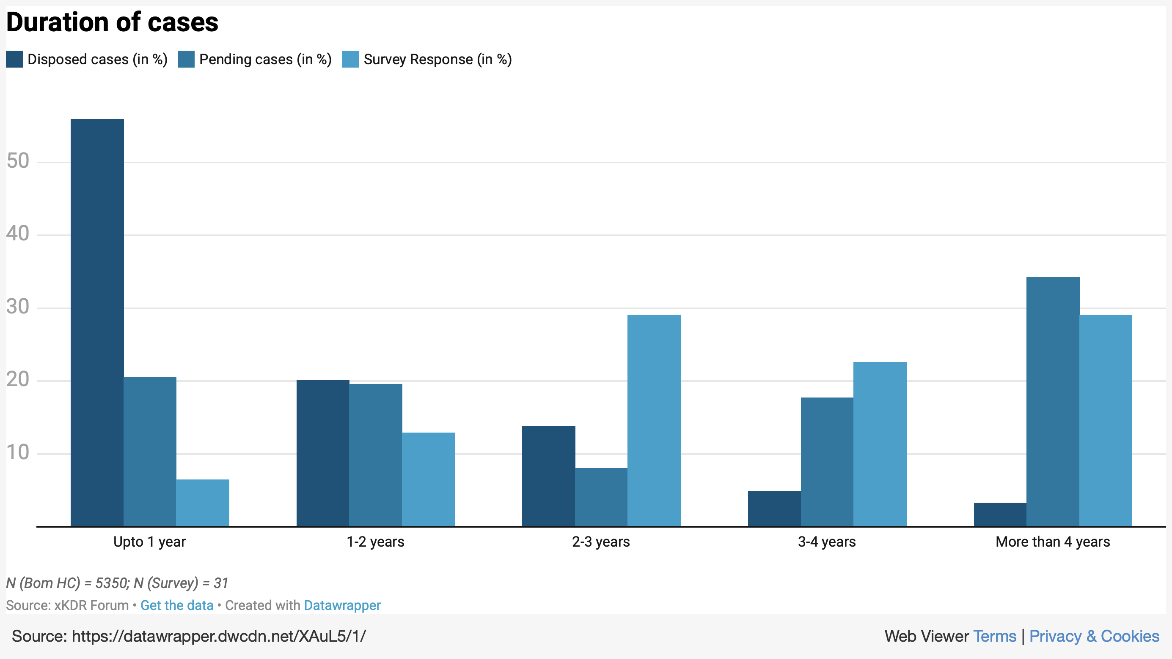

Slide 7
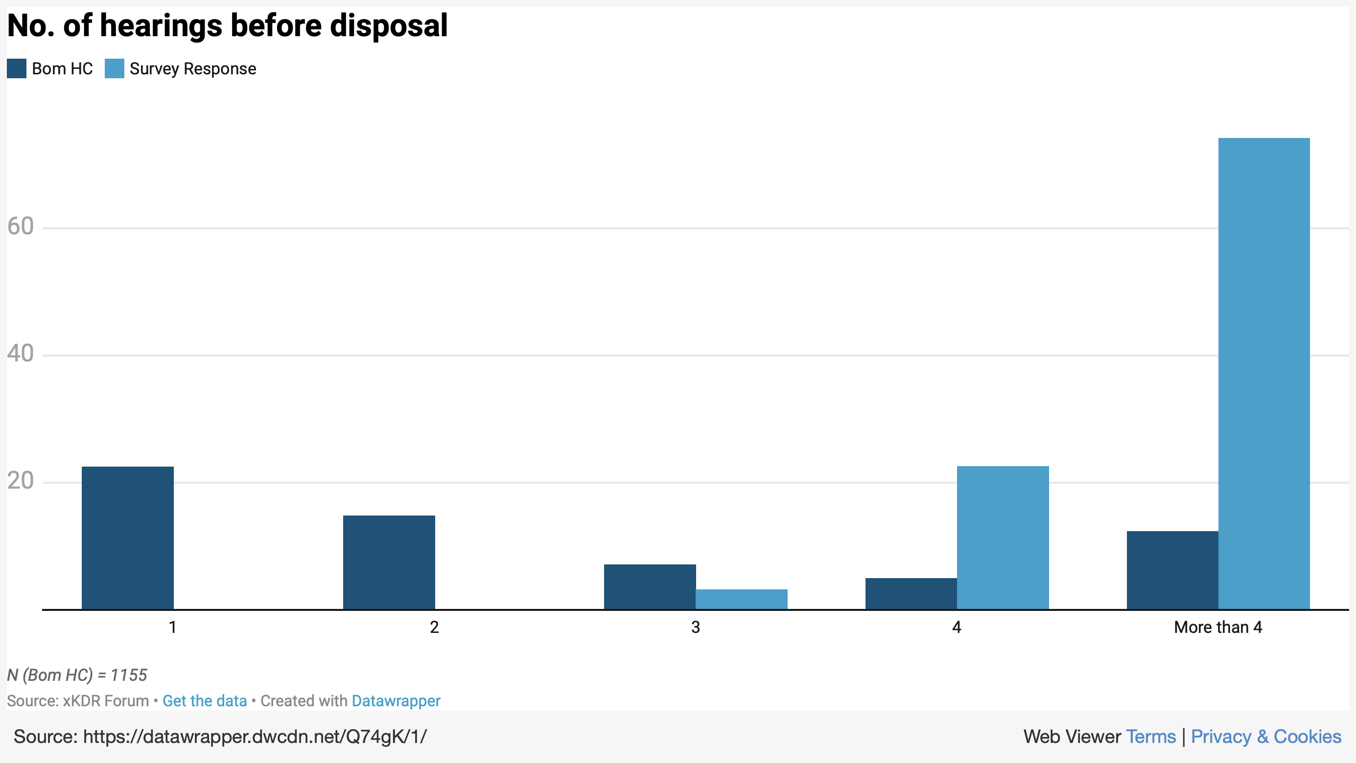

Slide 8
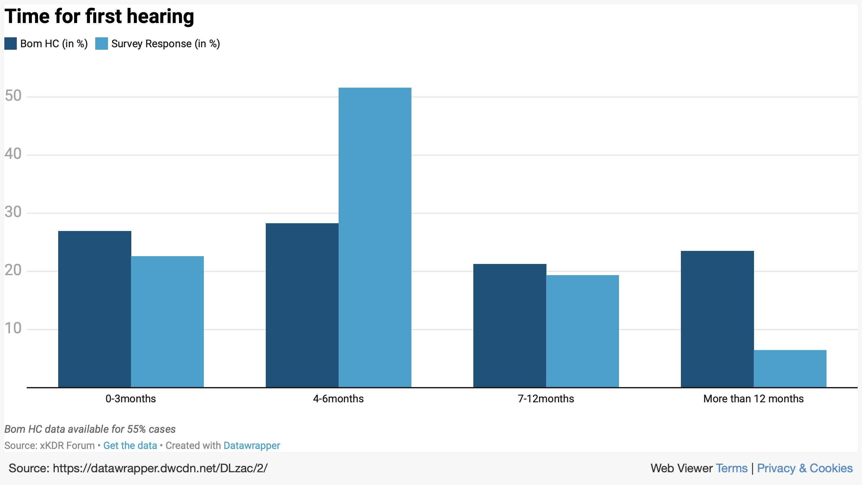

Slide 9
What if the litigant has a choice?

Slide 10
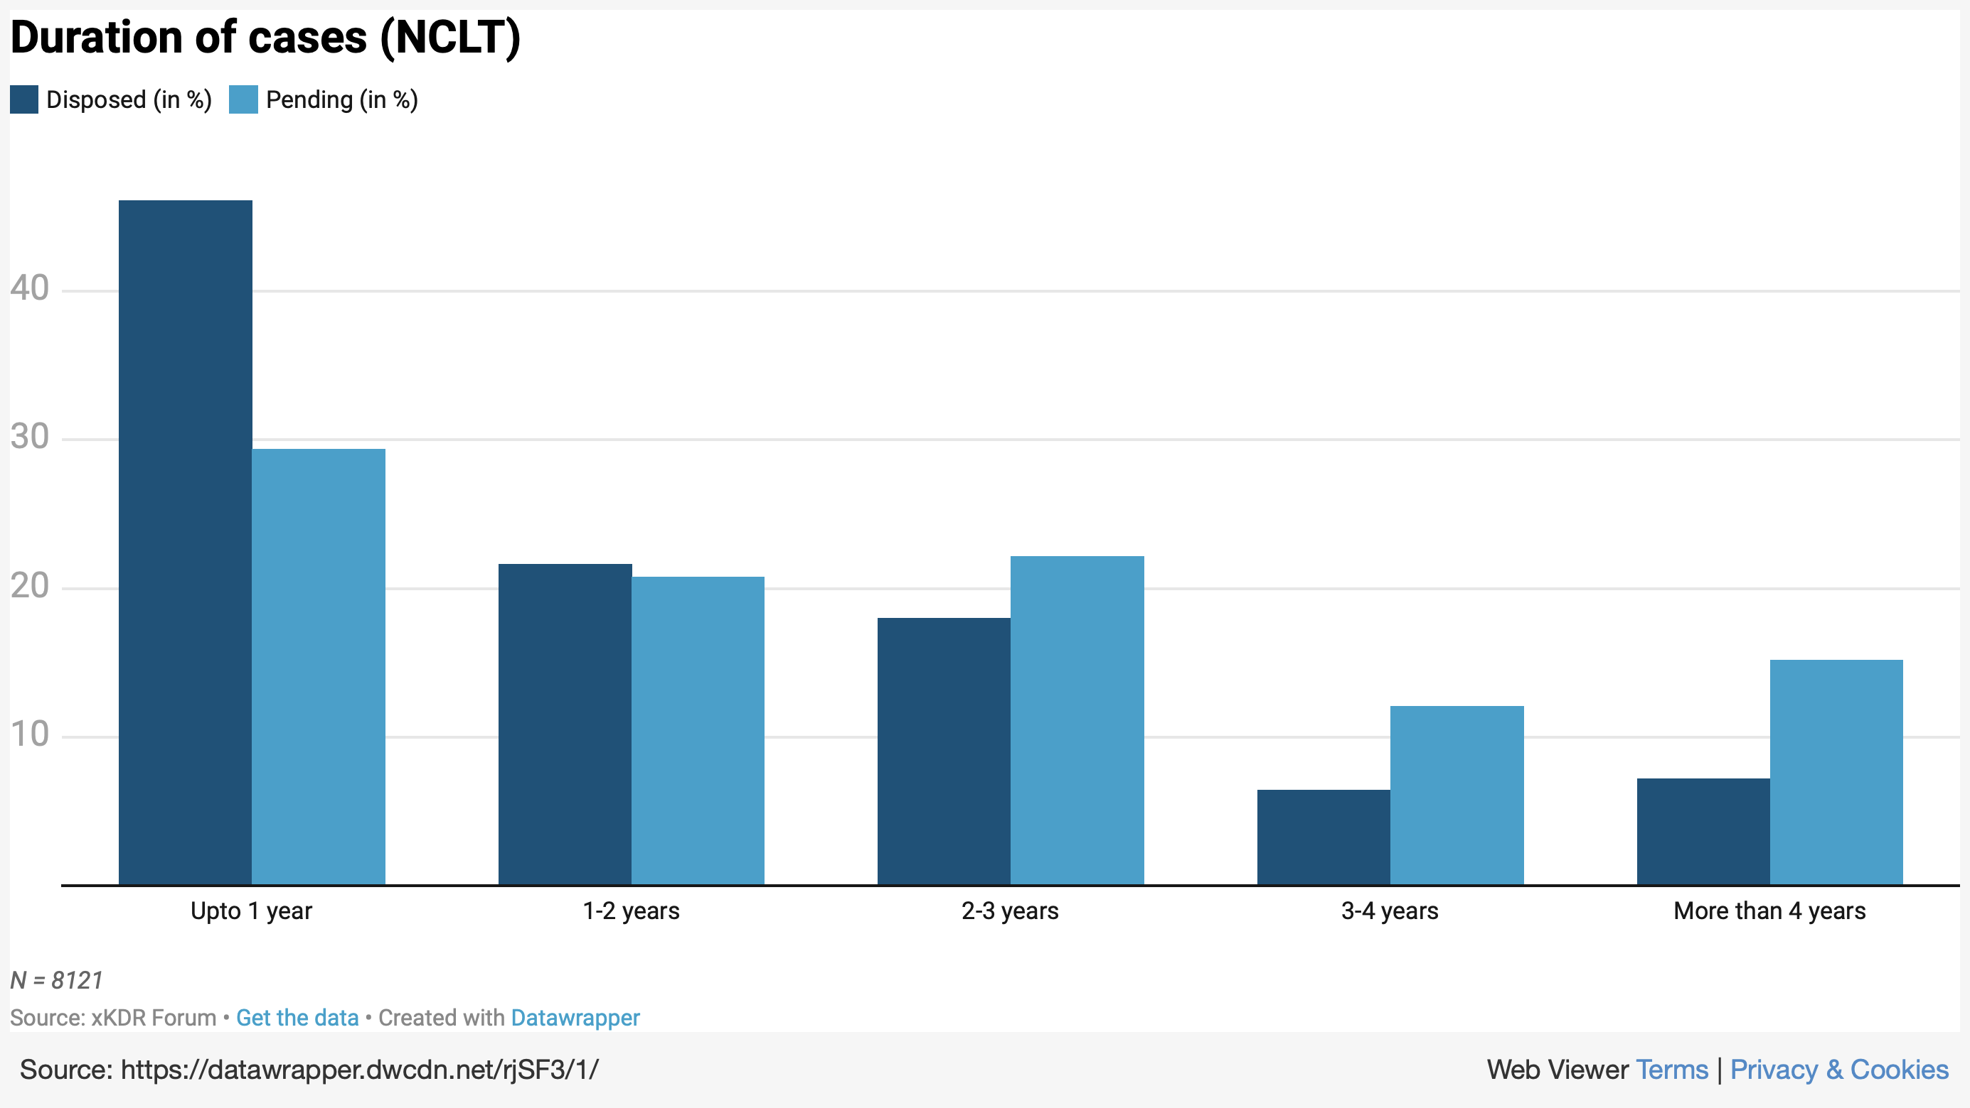

Slide 11
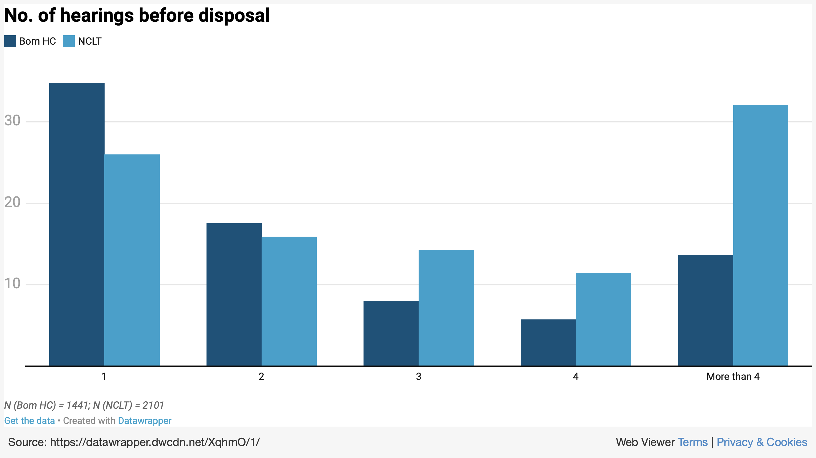
Notes:
https://datawrapper.dwcdn.net/XqhmO/1/

Slide 12
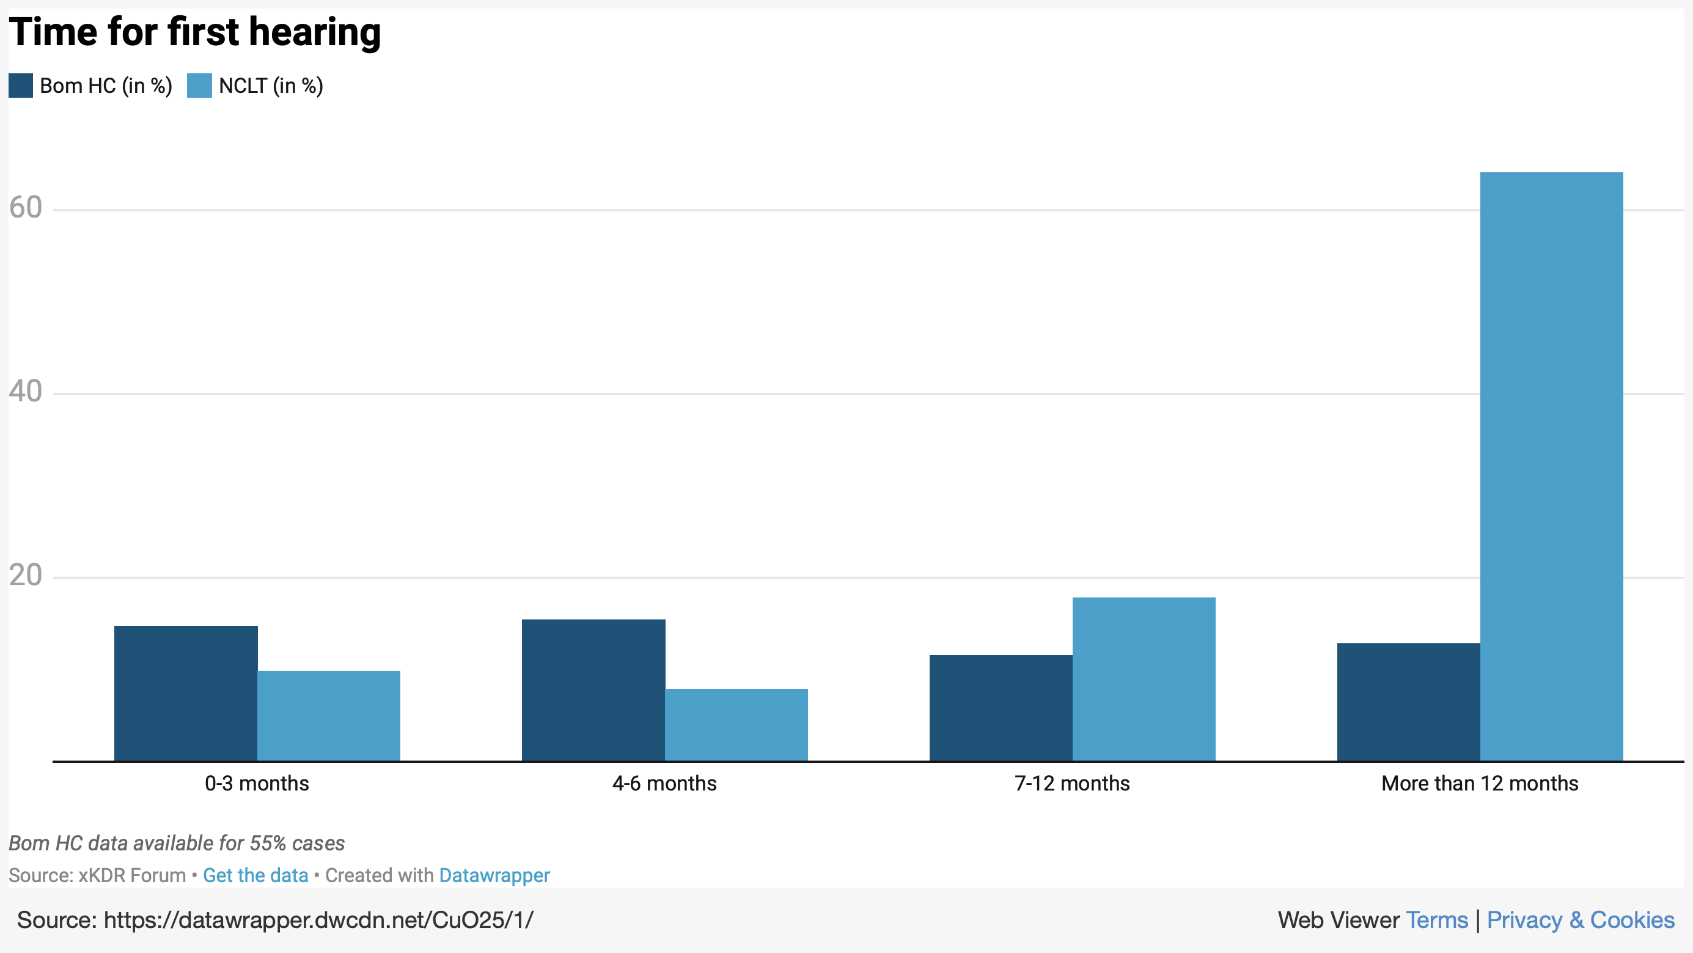

Slide 13
References
Clarke J, Borys D (2011). “Usability is free: Improving efficiency by making the courts more user friendly.” National Center for State Courts, Future Trends in State Courts, pp. 76–81.
Hagan MD (2018). “A Human-Centered Design Approach to Access to Justice: Generating New Prototypes and Hypotheses for Intervention to Make Courts User-Friendly.” Indiana Journal of Law and Social Equality, 6(2), 199–239.
Rottman DB, Tyler TR (2014). “Thinking about judges and judicial performance: Perspective of the Public and Court users.” Onati Socio-legal Series.

