Slide 1
NATIONAL TRIBUNALS COMMISSION
DAKSH
December 2021

Slide 2
Agenda
How and why did the idea of NTC come about
What would NTC mean – how will it look – what all can it do
Is NTC possible – what should it do

Slide 3
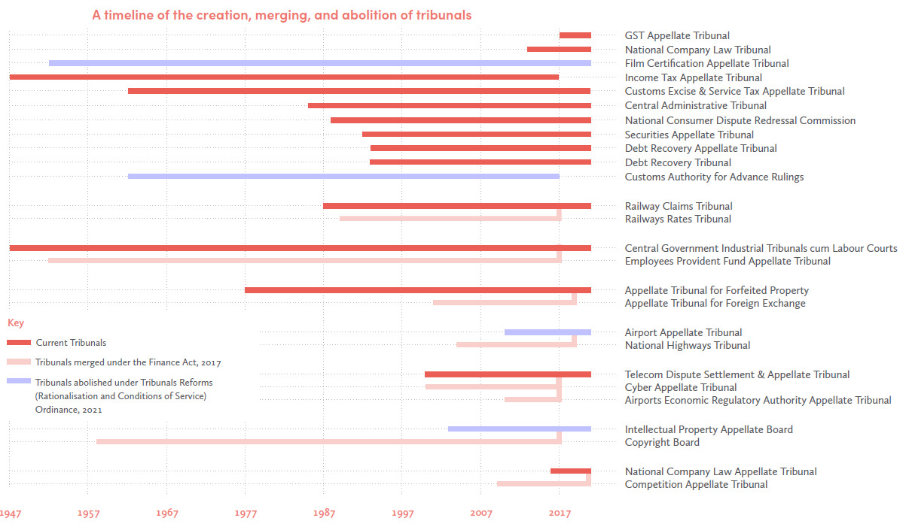
Tribunalisation in India

Slide 4
Pendency in tribunals

Slide 5
Sanctioned strength and vacancies in tribunals

Slide 6
Substantive problems of the tribunal system
Executive interference, inconsistent terms of appointment, service conditions, removal of tribunal members.
Narrowness of perspective of judges in tribunals
Over-tribunalisation and lack of Judicial Impact Assessments
Dependence on executive for resources, infrastructure, and premises

Slide 7
Procedural problems of the tribunal system
Outdated, inefficient processes, with inconsistent technological development
Non-uniform administration resulting from discrepancies in organizational structure
Pendency and delays, city-centric, hampering access to justice,

Slide 8
Evolution of idea of an NTC
L. Chandra Kumar v. Union of India
SC recommended Independent agency to oversee tribunals
Parliamentary Committee Report/ 272nd Law Commission Report
Idea of National Tribunals Commission endorsed
Madras Bar Association v. UoI
SC directed Central Govt. to create NTC, consolidate administration under Union Finance Ministry in interim
S.P. Sampath Kumar v. UoI
SC Recommended independent appointment mechanism for tribunals
Union of India v. R. Gandhi
SC recommended an umbrella agency to unify administration, implement reforms
Rojer Mathew v. South Indian Bank Limited
SC directed that Tribunals' expenditure should be charged, impact assessment to be conducted before creation, Minority opinions recommended NTC

Slide 9
Recent developments and progress
The Department of Expenditure, Union Ministry of Finance began taking steps towards consolidating tribunal administration to comply with the Madras Bar Association (2020) judgment
Tribunals Reforms (Rationalisation and Conditions of Service) Ordinance, 2021 was promulgated and later introduced as a bill in the Parliament in April 2021.
Certain provisions of the ordinance were challenged and the Supreme Court in Madras Bar Association (2021) judgment held that:
Imposition of minimum age limit of 50 years and 4 year tenure for tribunal members is unconstitutional
The term of tribunal members and chairpersons should be for five years, or retirement age, whichever is earlier; the court set the retirement age at 67 years for members and 70 years for chairpersons
The Bill was passed by both houses of Parliament and came into force as the law in August 2021. Despite being declared unconstitutional, the final statute retained the four-year term for tribunal members, and other contested provisions.
The Supreme Court has come down heavily on the government for unfilled vacancies in several tribunals.
Notes:
Change content

Slide 10
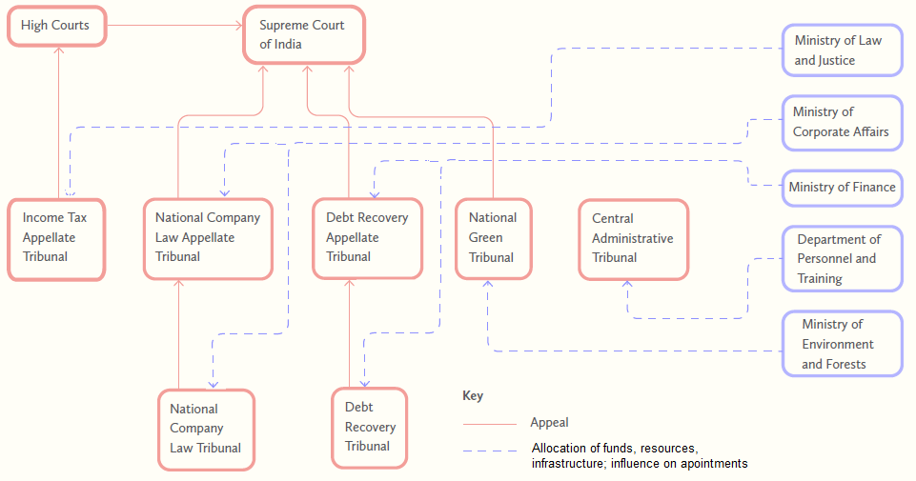
Before the NTC

Slide 11
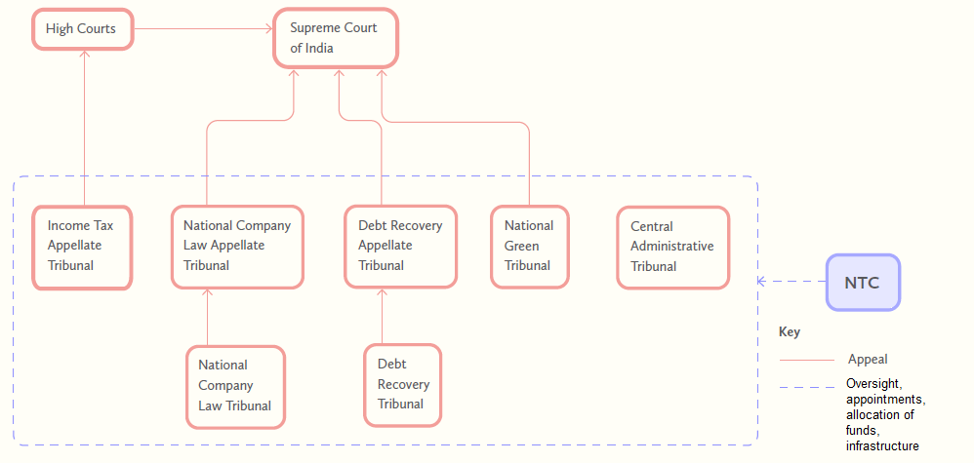
After the NTC

Slide 12
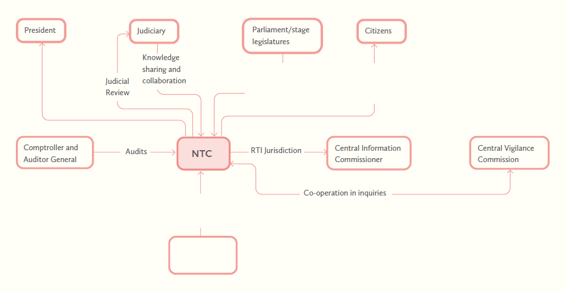
NTC’s relationship with other state organs
Legislative powers,
impeachment,
review of reports.
Publication of reports and
performance evaluation,
public consultation
Facilitate NTC's needs
in response to requests
Ministries

Slide 13
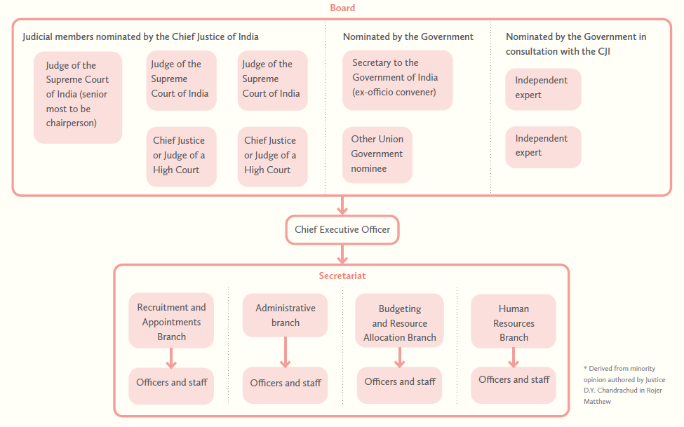
Organisational structure of the NTC
*

Slide 14
What should the NTC do?
The idea of an Integrated Courts and Tribunal Service to take care of the back office functions
The NTC will need executive (administrative), legislative (rules and policy making) as well as quasi-judicial (disciplinary) powers.
These powers will need to evolve with growth in the scope of the NTC’s role.
Appointment of members:
Appointment of judicial and technical members
Setting qualifications for tribunal members, uniform for judicial members
Staff-Related:
Appointment and oversight of administrative/registry staff for all tribunals
Administrative Oversight:
Conducting disciplinary proceedings, framing of rules and procedure
Developing performance metrics, process re-engineering, case flow management rules
Infrastructure and resources:
Oversee budgeting, procurement
Rationalisation of physical infrastructure, development of technological infrastructure along a platform model
Notes:
Split it into 2 slides

Slide 15
Discussion Questions:
Should there be a unified umbrella body in the form of the NTC to oversee the functioning of all tribunals?
What is the political economy perspective and institutional dynamics that bear on the existence of NTC?
Can the SC decisions directing the government to establish NTC be seen as an attempt by the judiciary to regain jurisdiction/control over areas that are currently under the remit of tribunals?
Tribunal system in India is plagued by several problems as discussed above. Is the NTC a solution to all of these problems?
Are there specific problems that the NTC best placed to tackle?
Are there other problems that the NTC may not be able to resolve, and therefore need a different solution?
Establishing the NTC in a phased manner:
Should its functions and powers be increased in a phased manner? What core functions should be vested on the NTC initially?
Should there be a sequencing of the tribunals which will be brought under the NTC’s purview? Which tribunals / sectors should be brought under the NTC first ?

Slide 16
Thank you

